Slide 1





Breakfast
Service
For
FS Managers
Provided by the LAUSD Food Services Division

Slide 2
To provide an understanding of the School Breakfast Program and its processes.
The following topics will be covered:
Program Rules
Breakfast Meal Count Forms
Breakfast Daily Meal Count Consolidation
(NEW) Newton BIC and Breakfast entry
Identifying Reimbursable Meals
Objectives
Notes:
TELL: The objective is to understand the BIC program and it’s processes . We will go over the meal service, including what a reimbursable meal is and the required classroom signage. We will identify how to enter student and adult meals into the CMS system. Furthermore, we will discuss the benefits of having a good communication system.

Slide 3

California Universal Meals
In 2022 California became the first state to implement a statewide Universal Meals Program for school children. California’s Universal Meals Program (Universal Meals) is designed to build on the foundations of the federal National School Lunch Program (NSLP) and School Breakfast Program (SBP).
Notes:
TELL: AFSS will complete a Breakfast in the Classroom site monitoring one time every two years.
50% of schools each year
The monitoring's are to be completed before February 1st

Slide 4
The Following compliance measures must be adhered to by the Program Sponsor:
  Attend State training and train staff
  Advertise the meal service
  Ensure civil rights compliance
  Monitoring of sites
  Submit claims for reimbursement on time
  Set up a record-keeping file for 2025-2026 Programs
    Retain all records for 3 years plus the current year
Program Sponsor
Responsibilities

Slide 5
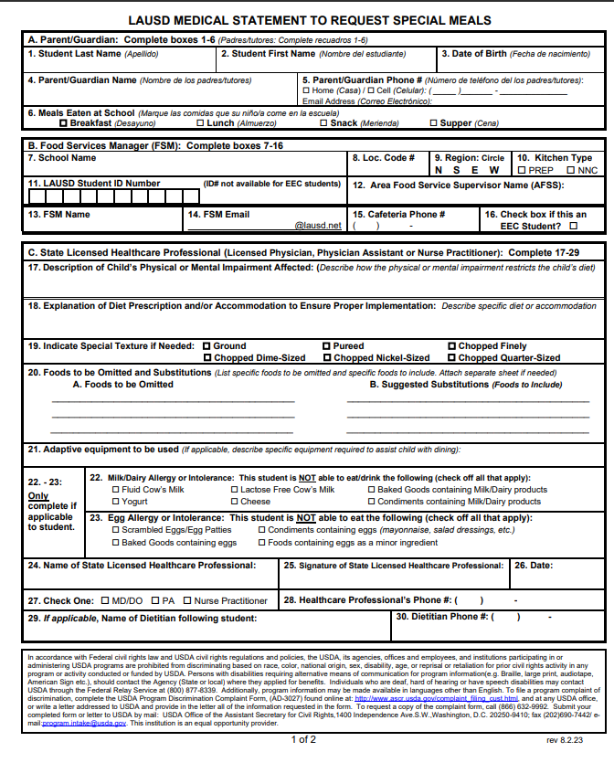
Requesting Special Meals
The Food Service Manager (FSM) will follow these procedures for requesting special meals for students not on file:
    FSM are to provide the “Medical Statement to Request Special Diets” to families for completion by the child’s treating physician
    The FSM will submit the completed “Medical Statement to Request Special Diets” form to specialdiet@lausd.net
    FSM will make substitutions based on the special diet provided by the Nutrition Specialist

Slide 6
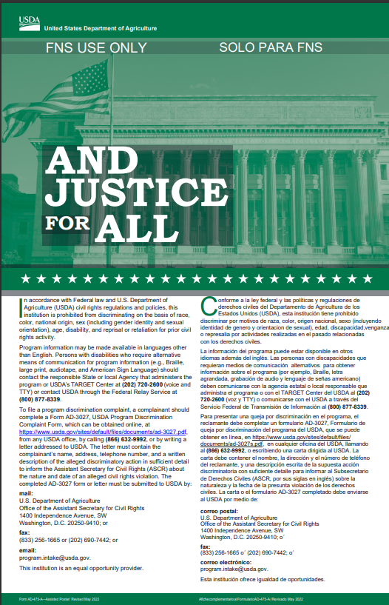
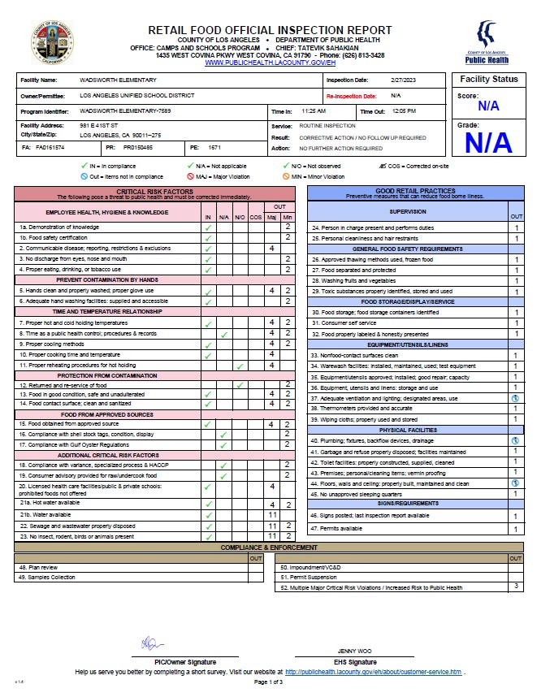
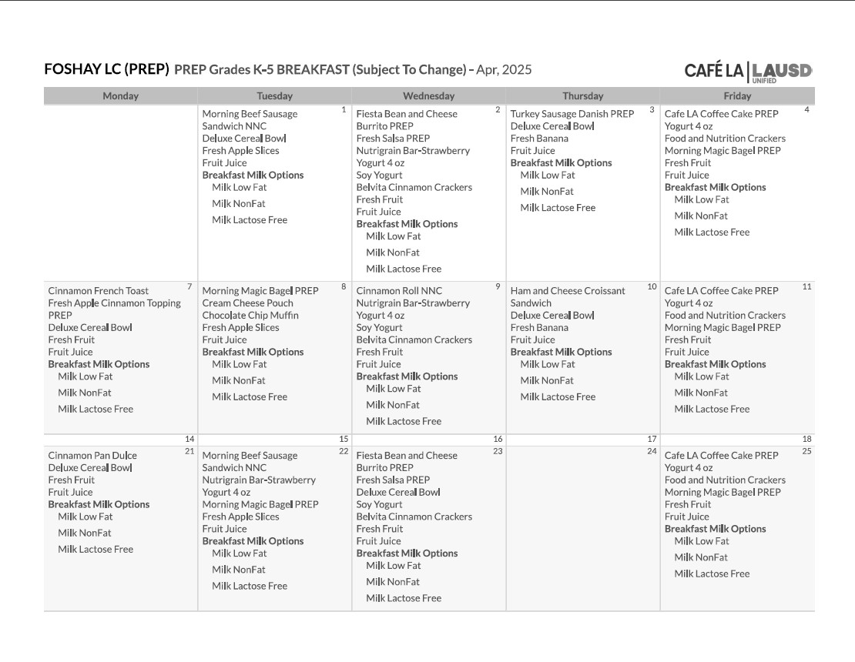
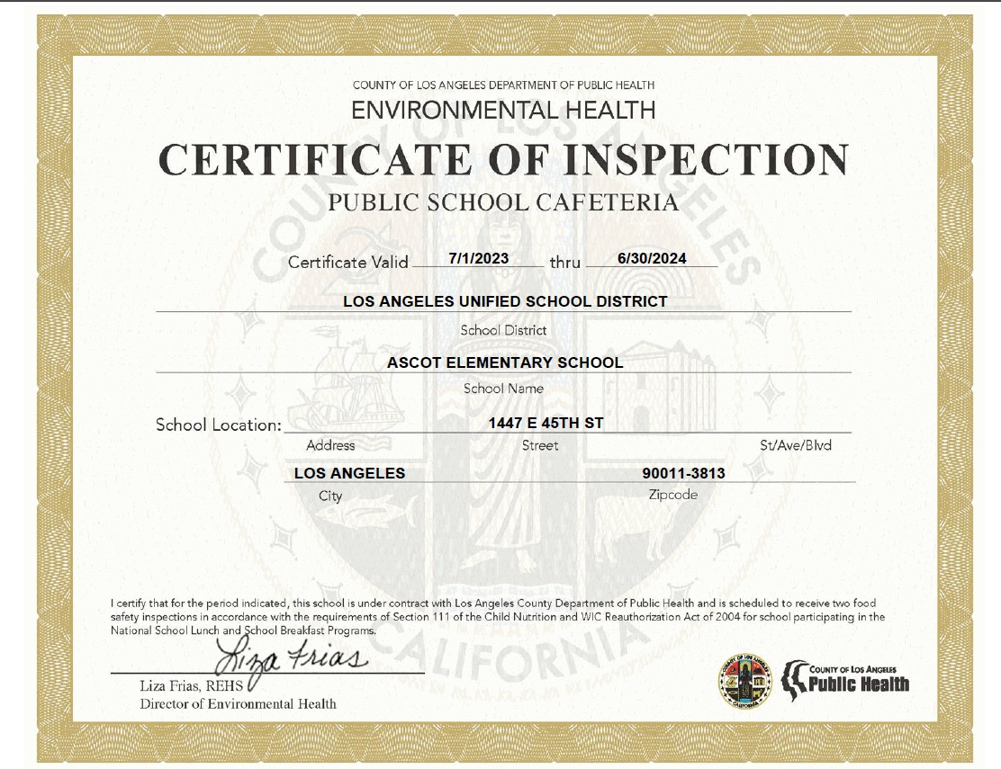
Mandatory Postings
The most current postings must be visible in the serving area where participants can view.
  “And Justice For All”
  Poster 11”x 17”
  Cafe LA
  Menu
  Health Inspection Report
  Health Department Certification

Slide 7



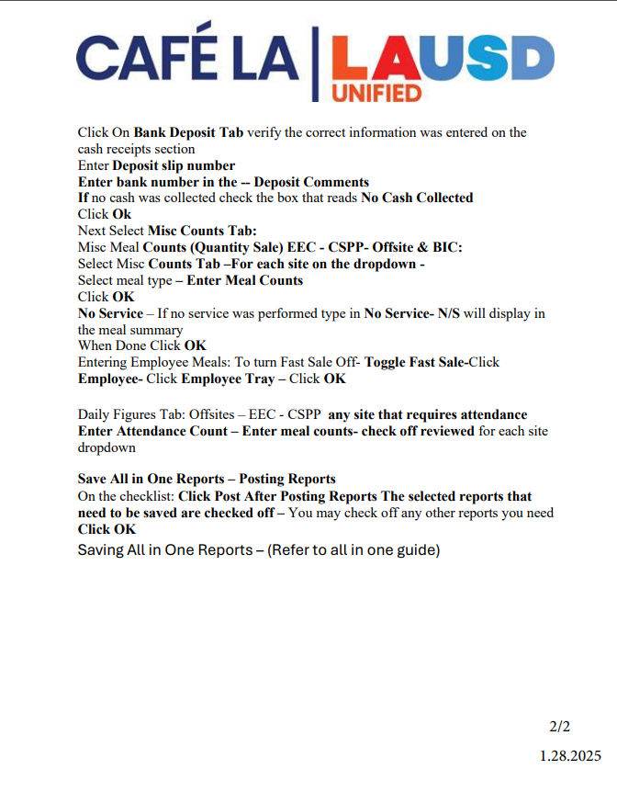
The Certificate of Inspection and the Health Inspection Report will both be posted in the managers office as well.

Slide 8
Point of
Service
Point of Service (POS) is when a determination can be made that all meal components have been offered and a reimbursable meal has been served to an eligible child. This usually occurs at the end of the serving line.
  Sites that serve breakfast will utilize one of the following:
BIC Service – “Breakfast Meal Count Form”
Cafeteria Service – Newton MCS-POS
  Elementary - Food Services Workers (FSW) will utilize student look-up by homeroom to claim students
  Secondary will use one of these three options
    Students will scan their identification card
    Students will enter their student pin number
    FSW will input students by utilizing the search by name function in Newton
Mobile Cart Service – “Breakfast Meal Count Form”
Secondary sites with wireless POS if available
Notes:
TELL: The Point of Service is the point in the foodservice operation where a determination can accurately be made that a reimbursable meal has been served to an eligible child. This normally occurs at the end of the serving line. This procedure is the same for breakfast and lunch. For breakfast, mark the students off on the roster and for lunch, the POS or rosters. There are no exceptions.

Slide 9

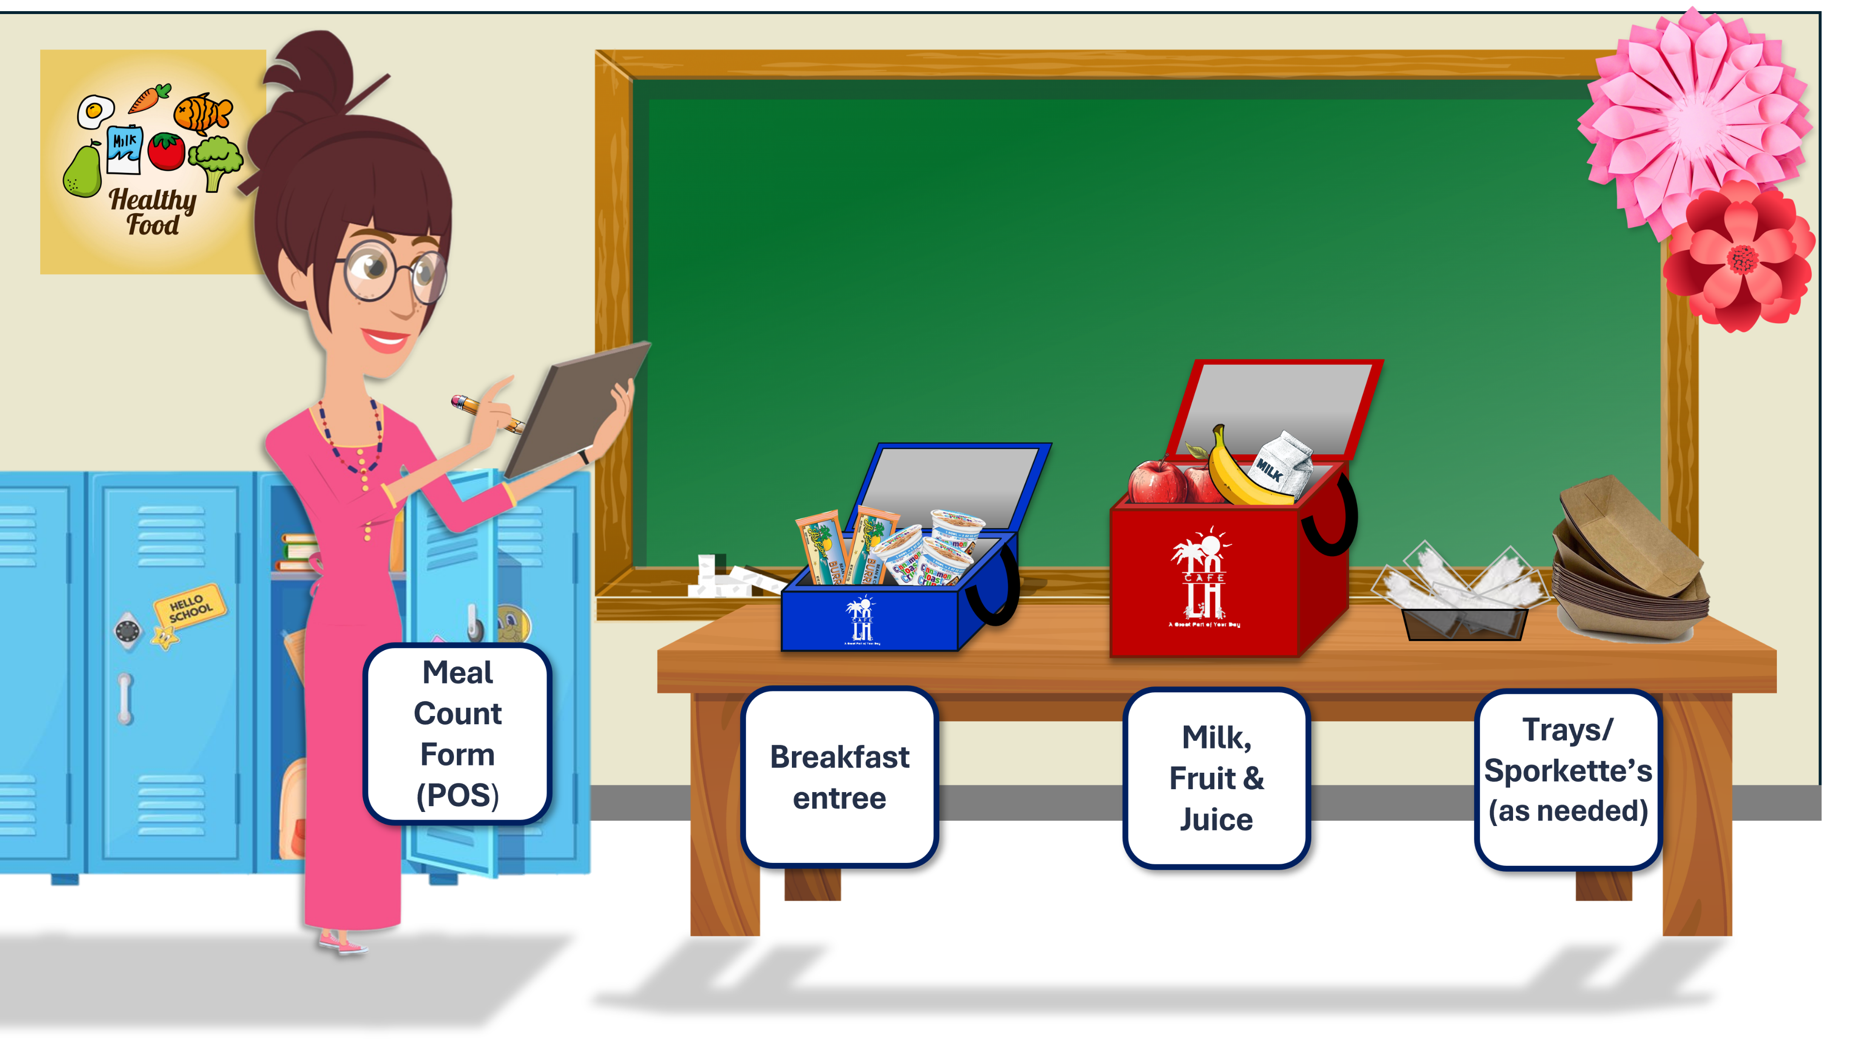
Classroom BIC POS Setup
Breakfast Rules
Student must take 3 or more points; one food item must be a fruit

Slide 10
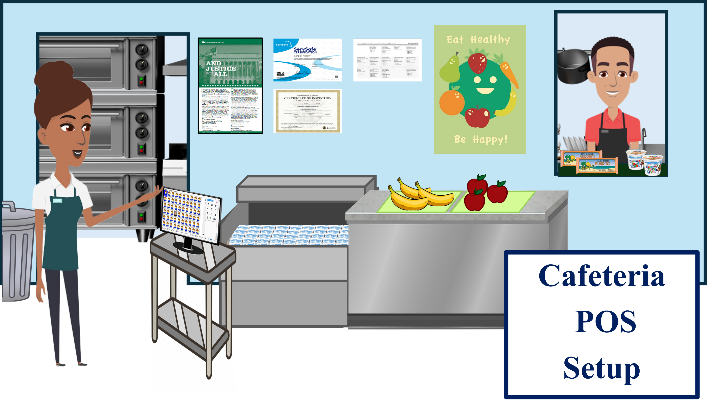

Slide 11
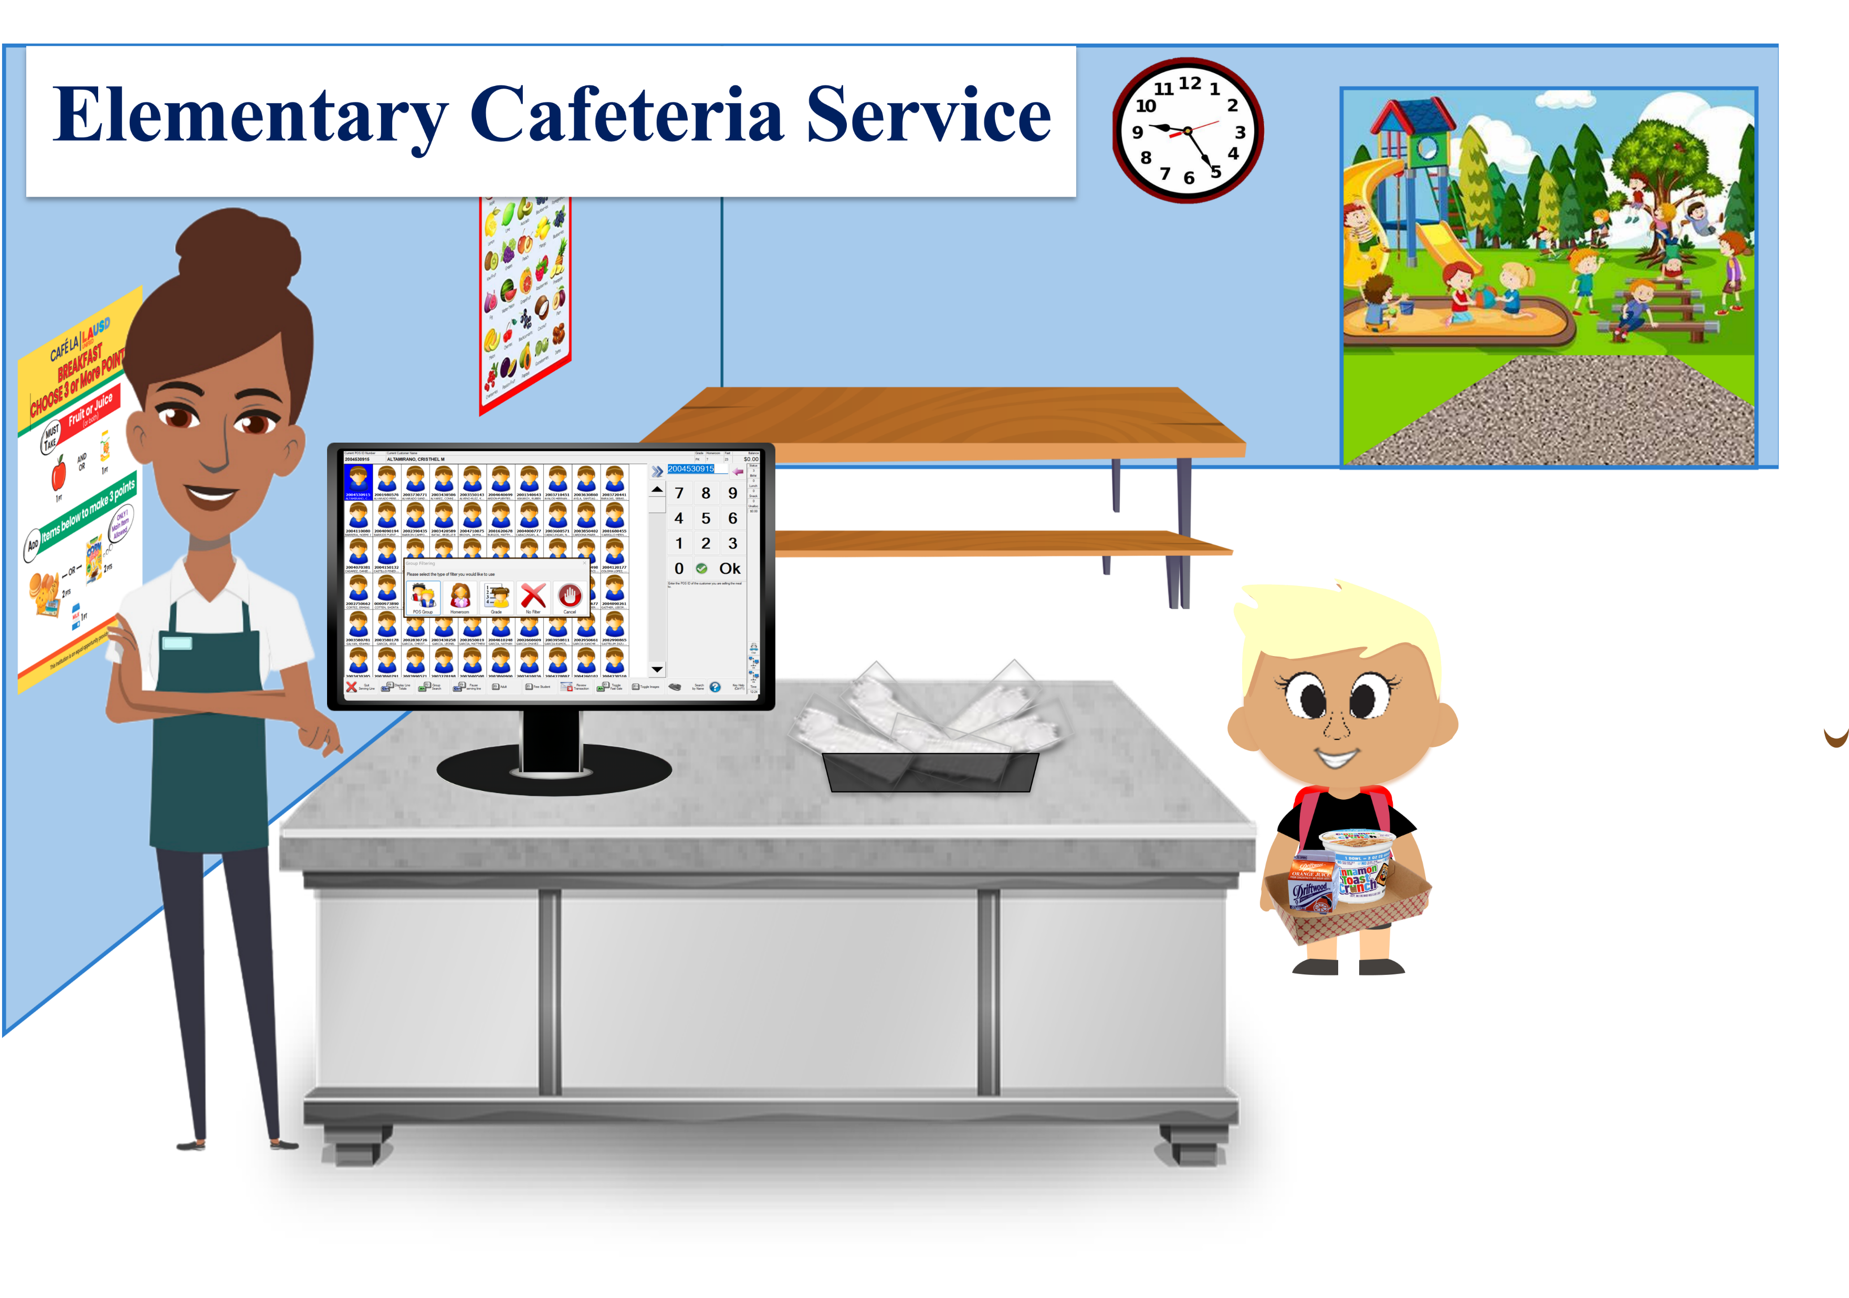
When a reimbursable meal has been served to an eligible student, food service staff will utilize student look-up by homeroom to claim students.
Visit the food service’s website for more best practices on claiming breakfast meals.

Slide 12
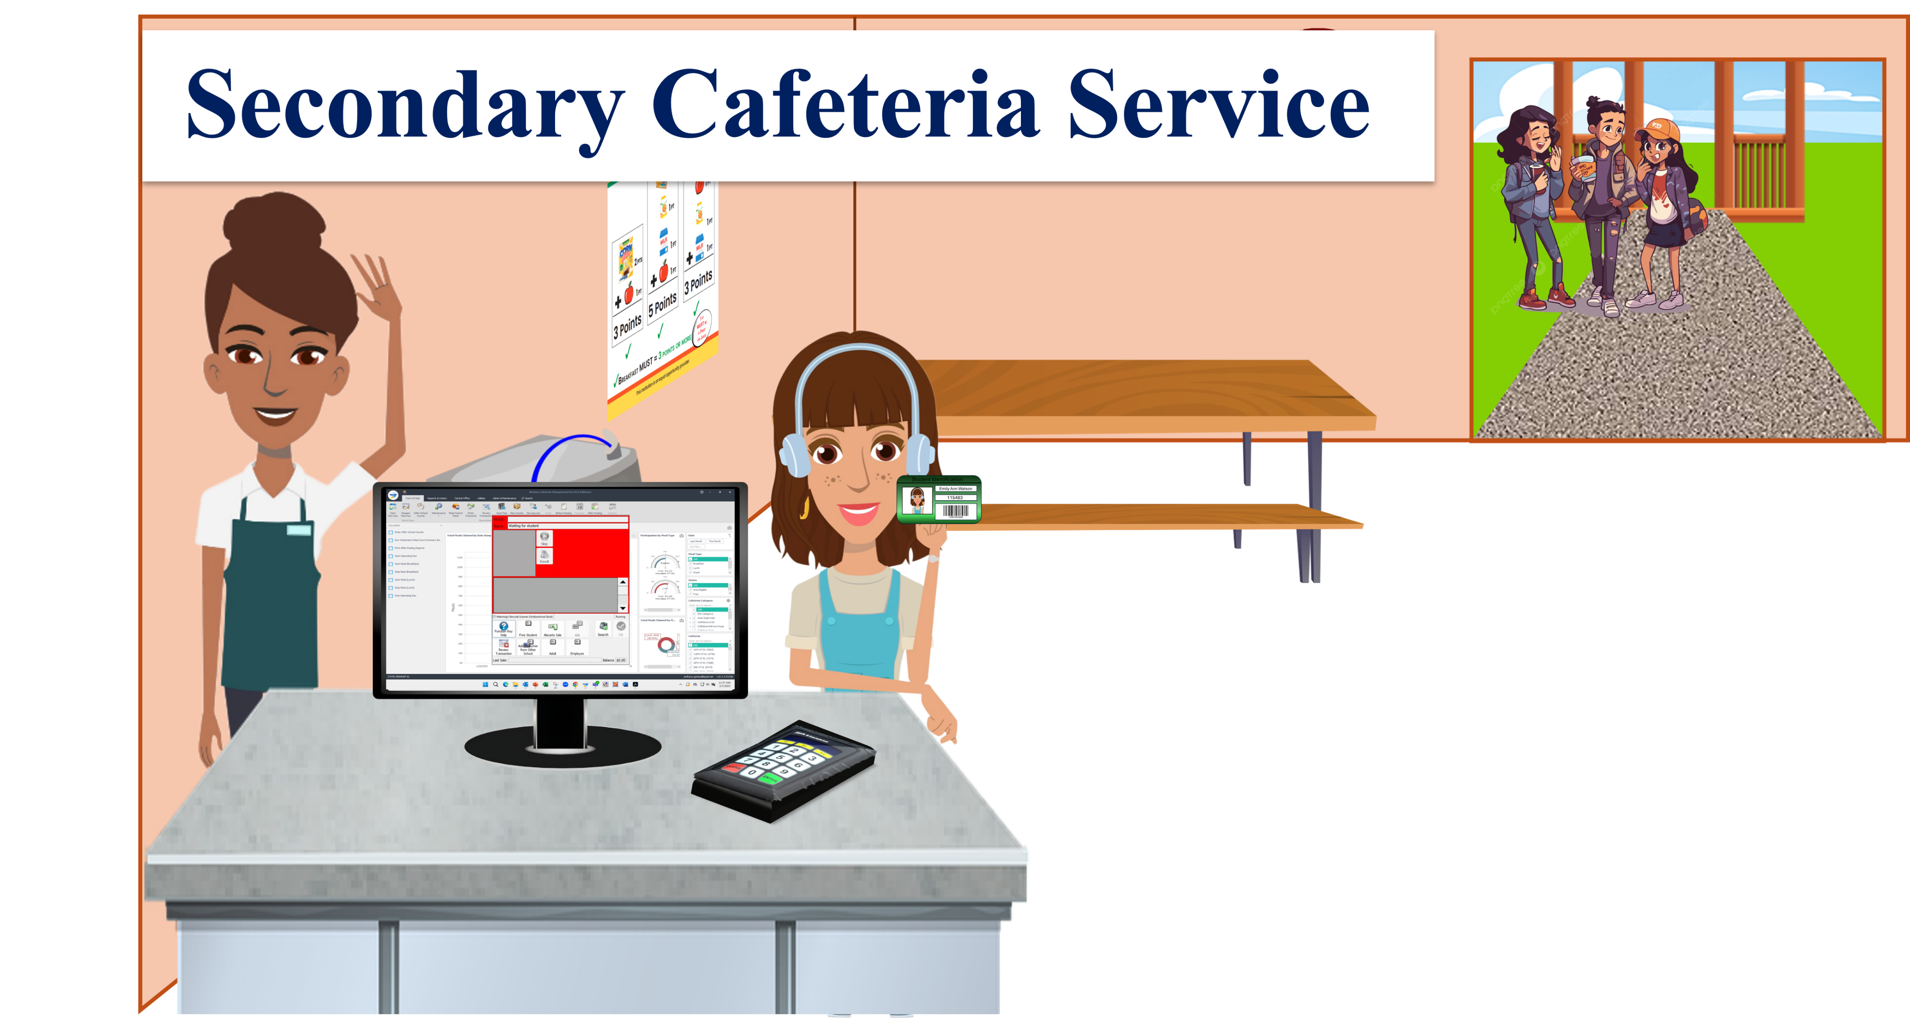
There are three different processes that will be used when claiming secondary students:
  Students will scan their identification card
  Students will enter their student pin number
  FS staff will input students by utilizing the search by name function in Newton.

Slide 13
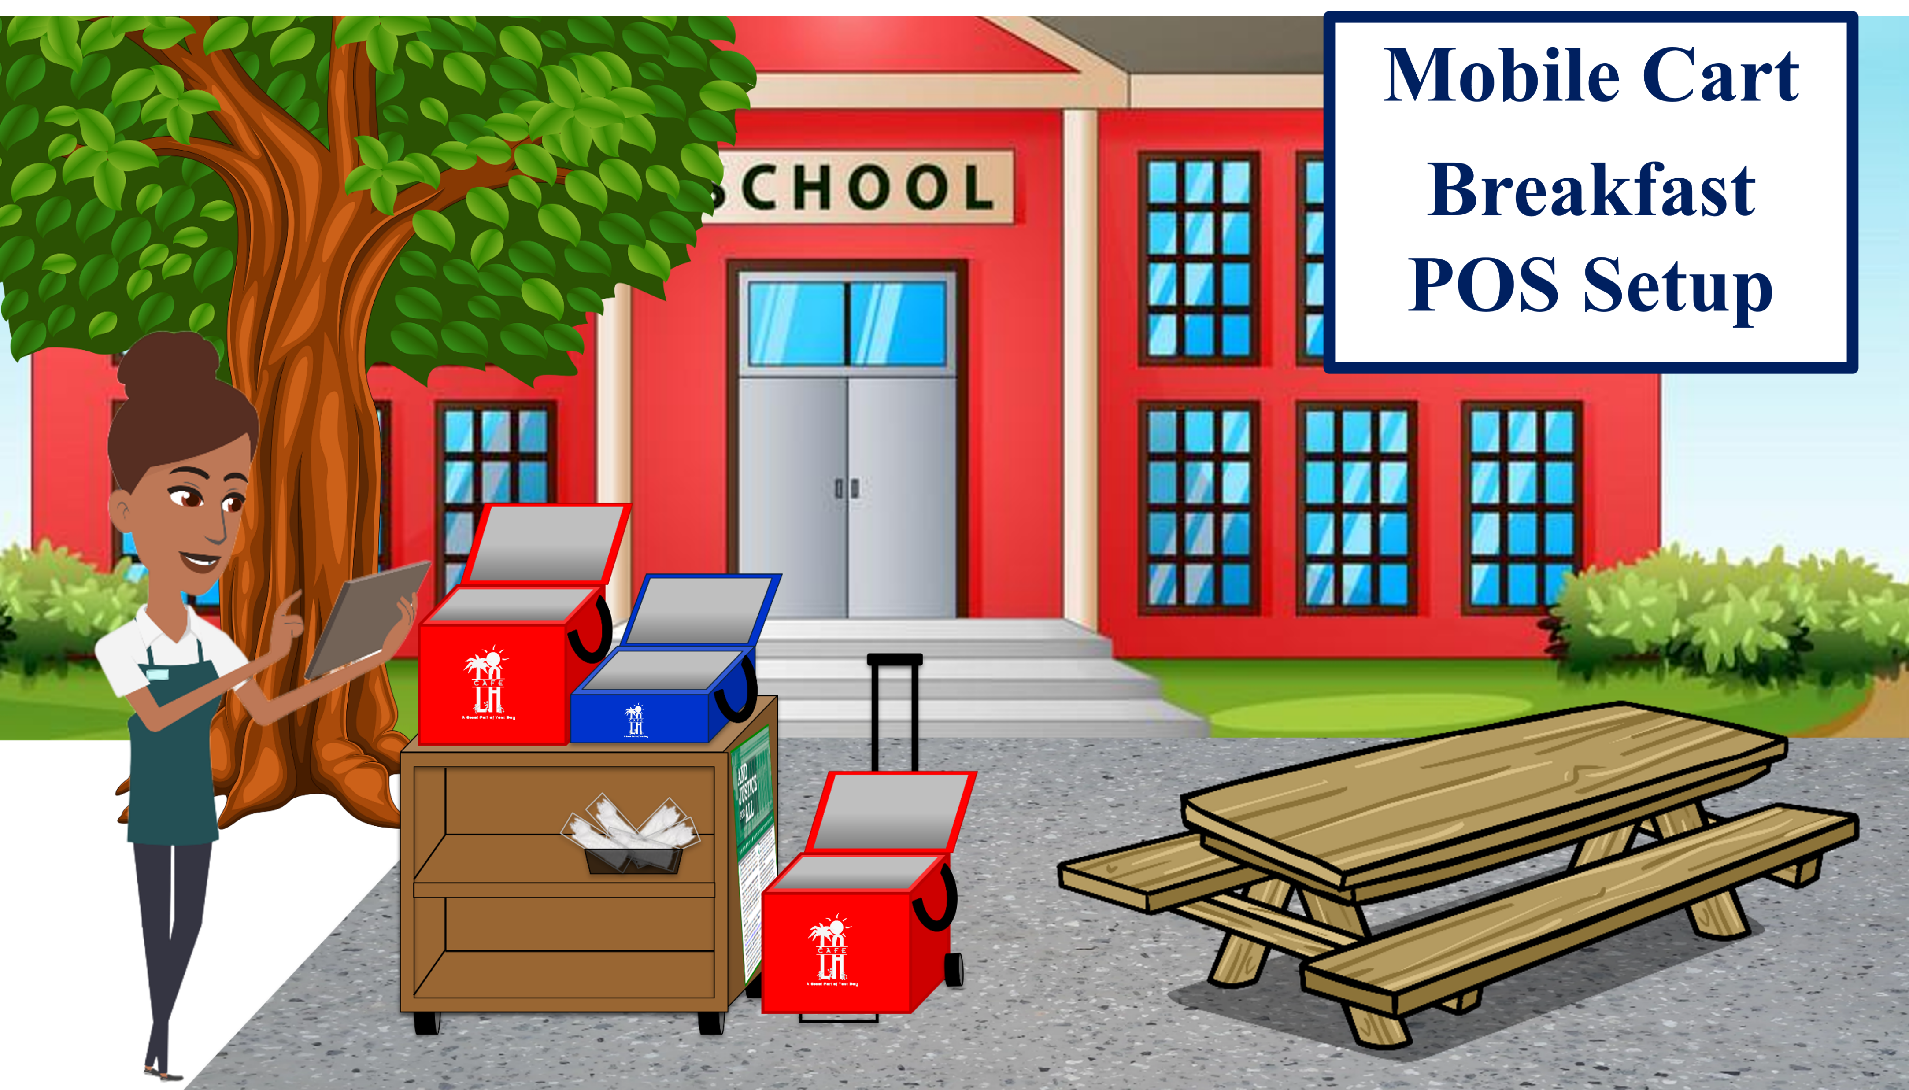
Notes:
Store less popular items in the same bag to maximize space
Do not crush or squeeze food items into bags; use an additional bag
This model allows for OVS

Slide 14
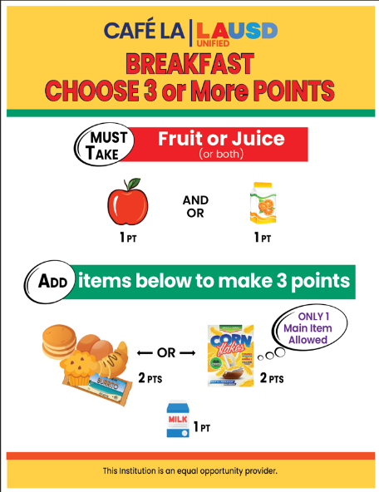
Breakfast
Offer Versus
Service

Slide 15

Offer Versus Serve Breakfast
Offer Versus Serve (OVS) allows students to decline some of the food.
Students do not have to take all food items offered in the school meal programs.
  Student must take 3 or more points; one food item must be a fruit
Notes:
TELL:Read slide

Slide 16



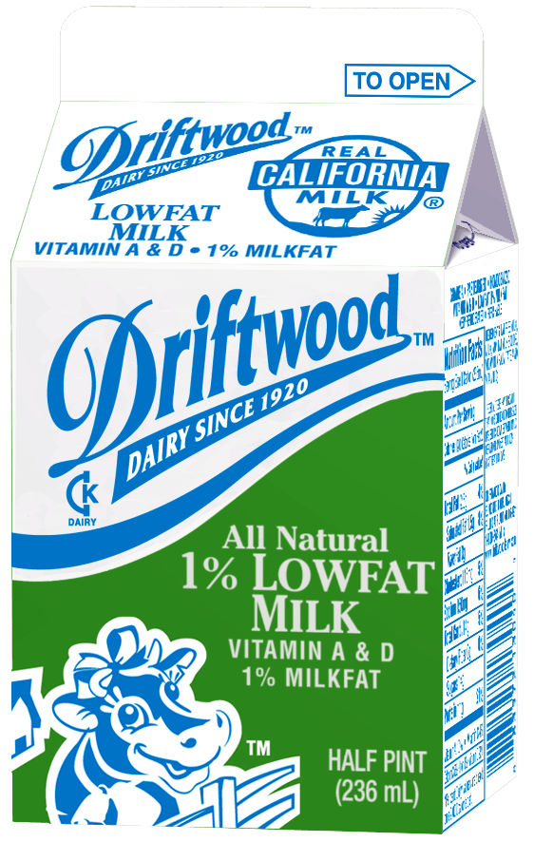




A FOOD ITEM is a specific food offered that can contain one or more food components and is counted as one whole item. Each food item is allocated a certain number of points.
Fruit Juice
1 Point
Grain + MEAT/MEAT Alternate
2 Points
Fruits
Grains
Milk
Breakfast Item
Points
Milk
1 Point
Whole Fruit
1 Point
Grain + Grain
2 Points

Slide 17





Main Item 2 Points At Breakfast
A meat/meat alternate is not required for School Breakfast Program. Any meat/meat alternates served during breakfast can be applied as a second grain as long as a grain is served on the same menu. Items with one component such as deluxe cereal and coffee cake would account for a grain + grain.
2 points
1st Grain (1 point)
2nd Grain
(1 point)

Slide 18

Fruit 1 Point at Breakfast
Students must take a fruit during the Breakfast Service period to claim a reimbursable meal. Fruit may be fresh, cooked, dried, canned, frozen or 100% juice. No more than ½ of the fruit offered can be juice (this includes frozen fruit items).
1 point
*Vegetables can be used in lieu of a fruit

Slide 19
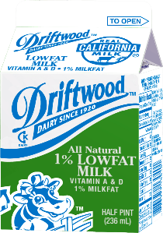
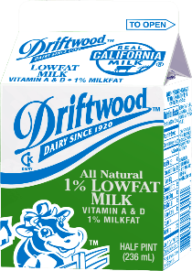

Milk 1 Point at Breakfast
All milk varieties are worth 1 point at breakfast:
Two forms of milk must be offered
1% low fat milk
Fat free milk
Flavored milk of any kind can not be served for breakfast service
Alternative milk is offered on request
Lactose- Free Milk (no form needed)
Soy Milk (Parental Request to Substitute Soy Milk required)
Almond milk, etc. (Special Diet Form required).

Slide 20











Each food item will account for a
certain amount of points
One food item must be a
Fruit Juice or Whole Fruit
Main food item’s are worth
2 Points
Breakfast is now based on a
points system.
Students must take a total of
3 points
All other food items are worth
1 point
Let’s see how they do in
the classroom
=
Fruit Juice
Deluxe Cereal Bowl
Deluxe Cereal Bowl
Yogurt & Crackers
Milk
Fruit Juice
Whole Fruit
1 point
1 points
2 points
2 points
3 points
1 point
1 point
2 points

Slide 21






Breakfast
Meal Service
Set-Up
That’s 3 points
Main Item is 2 points
Fruit Juice is 1 point
+
2 points
1 point

Slide 22
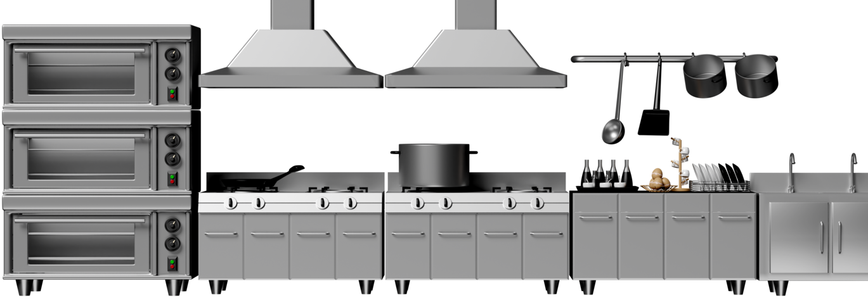


Students may take 2 food items as long as it totals to 3 points.
That’s Right!
Lets see another student.

Slide 23




Can students take 4 points?
Breakfast
Meal Service
Set-Up
And it looks like this student
is taking a banana too
Fruit juice is 1 point
Main Item is 2 points
That’s 4 points!
+
+
1 point
2 points
1 point

Slide 24
Students may take more than the recommended
3 points if they like!
That’s perfect!
Lets see another student.

Slide 25


Breakfast
Meal Service
Set-Up
But that’s not a reimbursable meal
Please take a fruit juice or whole fruit .
Milk is 1 point
That’s 3 points
Main Item is 2 points
+
+
2 points
1 point
1 point

Slide 26


A fruit with the meal!
Always remember students must take…
Amazing Job!
Fruit Juice
Whole Fruit
1 point
1 points

Slide 27
Breakfast Meal Count Form

Slide 28
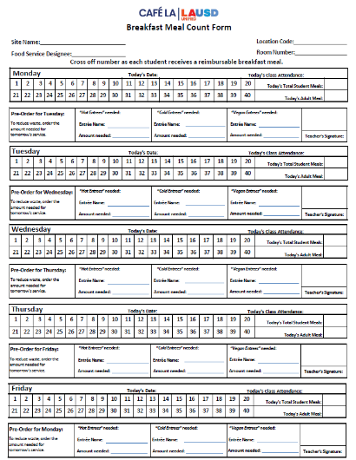
5-Day Breakfast Meal Count Form
Meals are not recorded by student's name for now in elementaries and secondaries for BIC unless the site has a HYBRID Breakfast Program.
  Teachers will cross off the number as each student receives a reimbursable breakfast meal in the classroom
  One-week duration, Monday – Friday
The “Breakfast Meal Count Form” can be found on the Food Services Website > Food Service Resources > Forms > “5 Day-BIC Meal Count Form”
Notes:
TELL: A “MiSiS Five Column Roster” is created in the MISIS system. For more instructions on printing MISIS Five Column Rosters, please visit the Food Services Division website under BIC.

Slide 29
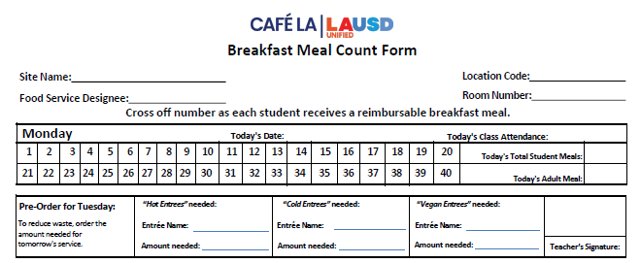
How To Fill Out Breakfast Meal Count Form
Food Service Manager or designee will fill out the following information for the next week, then make copies based on the number of BIC classrooms.
  Food Service Manager will add room number to copies
    Sites name
    Location Code
Beyonce Training Academy
808
Solange Knowles
15
8-15-2025
    Room Number is added once copies are made
    Name of
    Food Service designee
Egg & cheese
croissant
Yogurt & crackers
Cinnamon
Granola Cereal
    Name of cold entrée, hot entrée and vegan entrée based on your menu for next day service.
    For Instance: under Monday FSM will forecast for Tuesday Menu
    Date will be added for all 5 days of the week
Notes:
On Click

Slide 30
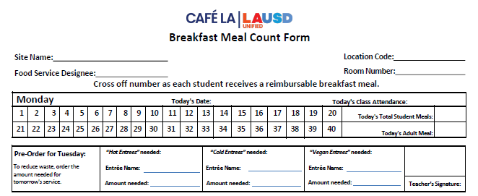
How To Fill Out – Teachers
During meal service, teacher or designated person will immediately mark off the breakfast meals as they are served.
    Cross off each number on the form after a child receives a complete reimbursable meal and write the total amount served
    Provide class attendance to assist in packing of BIC bags.
Beyonce Training Academy
808
Solange Knowles
15
8-19-2025
30
24
1
Egg & cheese
croissant
Yogurt & crackers
Cinnamon
Granola Cereal
    An adult meal will be provided, mark a “1” to indicate a meal was taken.
20
5
0
Kobe B. Bryant
    To reduce waste, order the amount needed for the next service day.
    Teacher will sign after confirming the
    amount needed.

Slide 31



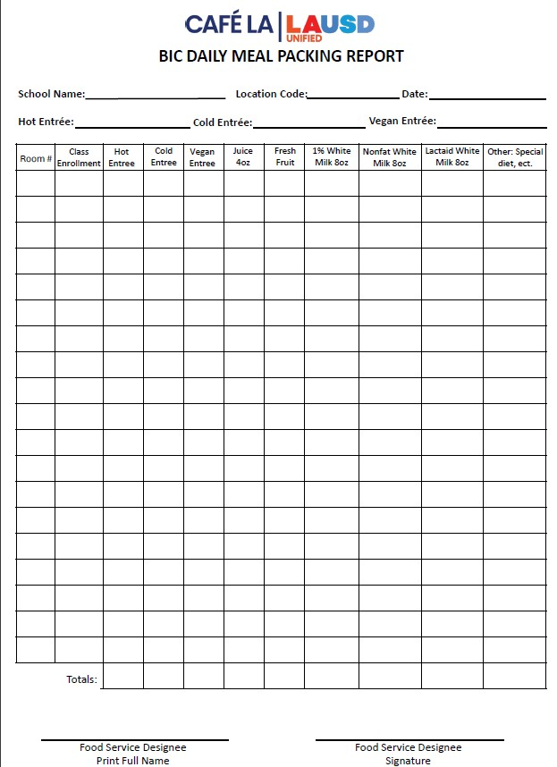

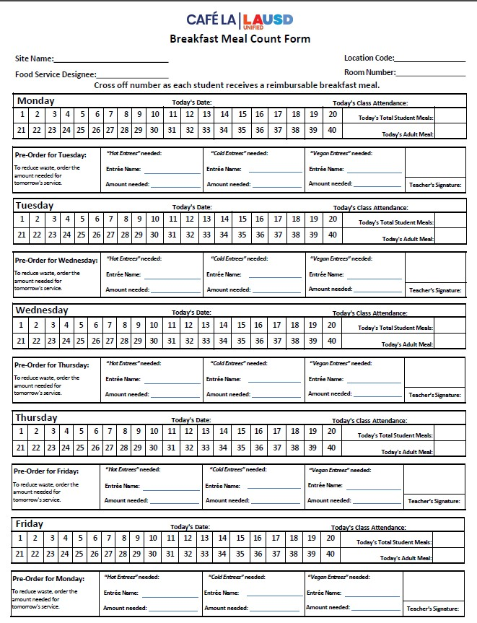



That’s ok, Its not mandatory for teachers to sign. But I’ll leave a note for tomorrow so hopefully they don’t forget!
But it looks like the Teacher didn’t sign or forecast for the next day!
And previous BIC Meal Packing Reports
Oh look! The BIC bags have returned.
Previous Breakfast Meal Count Forms
And in the event, they do still forget I will continue to use…
Beyonce Training Academy
808
Solange Knowles
15
To make my forecasts for BIC meal service.
8-15-2025
30
24
1
Egg & cheese
croissant
Yogurt & crackers
Cinnamon
Granola Cereal
Please don’t forget to sign
Thank you!
-Café LA
Manager
15
23

Slide 32

Federal Government Regulations
The “Breakfast Meal Count Form” is a legal document kept on file for three years for audit purposes.
This legal document supports the funds received from the state and federal government for reimbursable meals.

Slide 33
BIC Daily Meal Packing Report

Slide 34
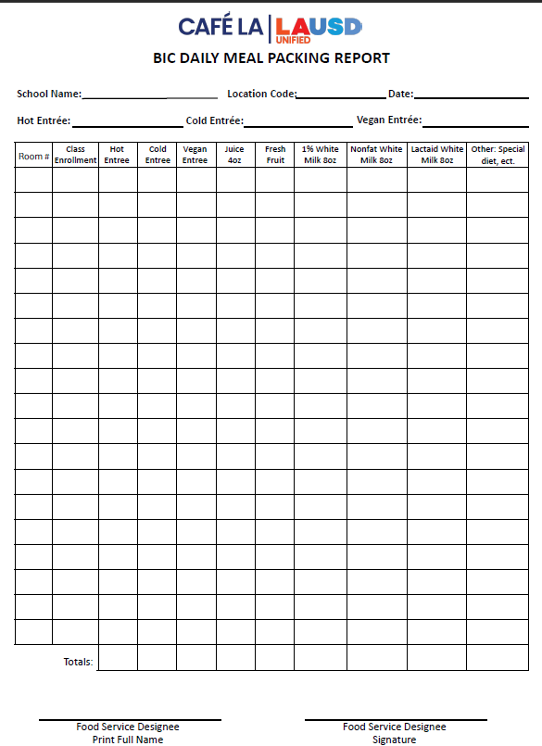
How To Fill Out Daily Meal Packing Report
FSM or designee will complete the date, location code, name of the school and menu items.
Beyonce Training Academy
808
8-15-2025
Write the quantities of each food item packed inside the BIC bags. Quantities are based on student participation, not the classroom enrollment.
Egg &
cheese croissant
Cinnamon
Granola Cereal
Yogurt & crackers
3 30
4 25
20
9
1
30
25
20
5
0
22
2
1
25
20
20
5
0
FSM or designee will provide the room numbers and class enrollments of each BIC classroom in the room and enrollment column.
Total each column and indicate the amount packed in the “Totals” section.
Food Services staff will print name and sign to verify the form is completed accurately.
42
11
2
55
45
40
10
0
Blue Ivy Carter
Blue Ivy Carter
Notes:
TELL: F S Staff will complete the BIC Daily meal packing report. Start by indicating the name of the school, the location code, and the date of service. In the first two columns write the room number and enrollment for each class. When complete food service staff will print their name and sign the form to verify the information is correct.

Slide 35


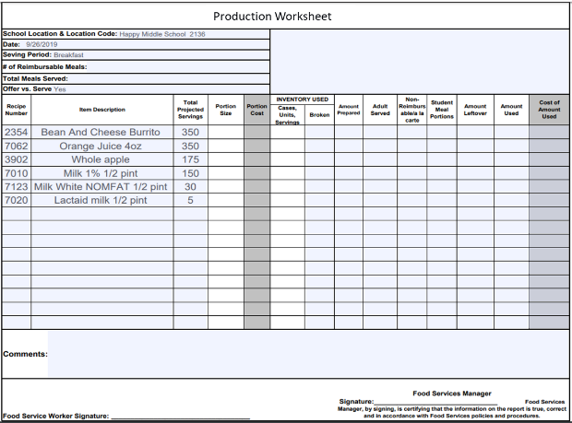
Transferring Totals To Production Worksheet
BIC DAILY MEAL PACKING REPORT
Date: |  | Location Code: |  |  | School Name:
Room # | Enrollment | Entrees Provided | Juice Provided | Fruit Provided | 1% White Milk Provided | Nonfat White Milk Provided | Lactaid White Milk Provided | Other: Special Diet, Soy Milk, ETC
1 | 30 | 25 | 25 | 10 | 8 | 2 | 0 | 0
2 | 27 | 20 | 20 | 10 | 8 | 2 | 2 | 0
3 | 30 | 25 | 25 | 10 | 10 | 2 | 0 | 0
4 | 23 | 22 | 22 | 12 | 8 | 2 | 0 | 0
5 | 45 | 38 | 38 | 10 | 10 | 2 | 1 | 0
6 | 33 | 29 | 29 | 15 | 10 | 2 | 0 | 0
7 | 31 | 29 | 29 | 10 | 10 | 2 | 0 | 0
8 | 30 | 25 | 25 | 15 | 8 | 2 | 0 | 0
9 | 25 | 20 | 20 | 10 | 8 | 2 | 0 | 0
10 | 32 | 29 | 29 | 15 | 10 | 2 | 0 | 0
11 | 15 | 15 | 15 | 15 | 13 | 2 | 0 | 0
12 | 30 | 30 | 30 | 15 | 10 | 2 | 2 | 0
GYM | 45 | 29 | 29 | 15 | 10 | 2 | 0 | 0
Totals: |  | 336 | 336 | 163 | 123 | 26 | 5 | 0
Name: |  |  |  | Signature:
9/26/2019
2136
Happy Middle School
When the totals section is completed, transfer amounts to the “Production Worksheet” in the amount prepared column.
3/20/2025
The amounts recorded on the “Production Worksheet” should be the same as the totals on the “BIC Daily Meal Packing Report”.
336
336
163
123
26
5
Notes:
TELL: Read slide

Slide 36
A La Carte Sales Inventory Form

Slide 37
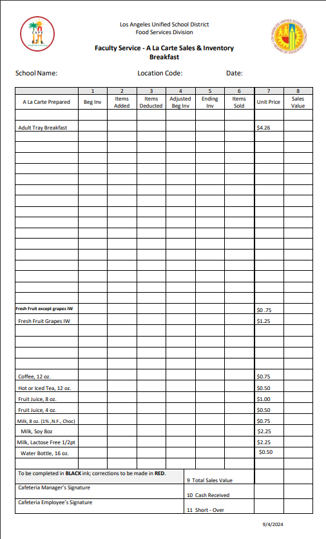
A La Carte Sales and Inventory Form
Use the “Faculty A la Carte Sales and Inventory” form to record BIC Adult and LAUSD paid staff meals.
FSM or designee will write in the menu items for the day under Tray Breakfast
Cinamon Toast Cereal
42
19
23
Bean & Cheese Burrito
42
14
28
Yogurt & crackers
42
9
33
Whole Banana
42
34
8
Beginning Inventory is a combination of:
  Available Faculty Meals (8)
  Employee Meal Allowance (4)
  BIC Adults (30)
milk
42
34
8
Subtract the number of adult BIC meals and employee meals taken in column 3 Item’s Deducted
Adjusted Beginning Inventory will then be used in the faculty dinning room for service

Slide 38
Breakfast In The Class

Slide 39
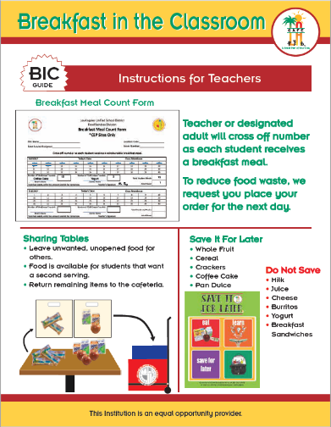
Teacher BIC Guide
The “Teacher BIC Guide” aids teachers or designees with the BIC process:
Place checkmarks for students that take a reimbursable meal
Do not place a checkmark if the student did not take a meal or all required items
Share table items are returned to the cafeteria inside the plastic bags. Unserved items will be kept in insulated bags separate
Follow the “Save it For Later” guidelines

Slide 40
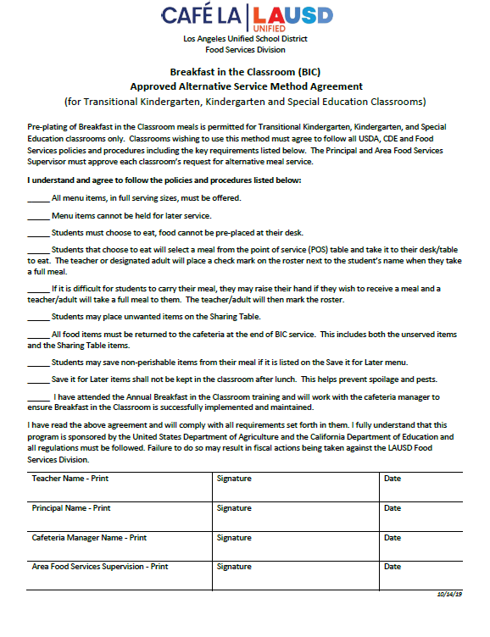
Pre - Plating Guidelines
Upon Food Services approval Transitional Kindergarten, Kindergarten, and Special Education classes may pre-plate breakfast meals for the students.
Food cannot be placed directly at the student's seat
Students receive meals from the POS or raise their hand while seated to receive a meal
Students need to be offered all items
Full servings for each item must be provided
Adults may assist students carrying meals

Slide 41


BIC Point Of Service
The teacher or designee should supervise the breakfast service to ensure a reimbursable meal is taken by each participating student.
Each student is permitted one BIC meal per day.
Students may not take more than one of each food item offered. (ex. 2 juices, 3 burritos)
Encourage students to take a reimbursable meal.

Slide 42

BIC Unserved Items
  Unserved items are considered the unselected food remaining in the BIC insulated bags at the end of meal service. These items will be left in the insulated bags along with share table items to be returned to the cafeteria.
Notes:
Tell: Read slide

Slide 43
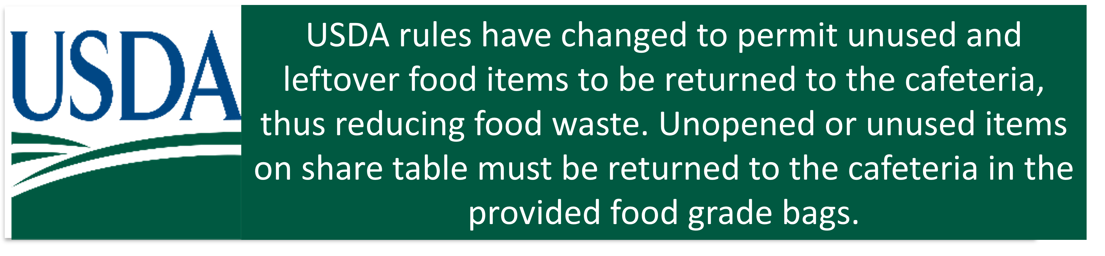
Sharing Tables
After receiving a meal, students may place items they do not wish to consume on a sharing table.
The sharing table is for:
Students that want additional portions.
Selected items that are unopened and unused.

Slide 44
Not Too Hungry... Save It For Later
To keep waste down students may save non-perishable items from the menu that day.
Whole Fruit
Cold Cereal
Crackers
Coffee Cake
Pan Dulce

Slide 45


BIC Share Table
Items selected by the students and not opened, can be placed in the food grade bags on the share table.
Hot items in one bag and cold/shelf stable items in the other.
Notes:
Tell: Read slide

Slide 46



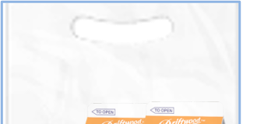





At the end of the service period, the BIC Meal count report, BIC bags with any leftover unserved items, and the share table bags must be returned to the cafeteria.
Notes:
Tell: Read slide

Slide 47
BIC Expectations

Slide 48

Role of The Food Service Staff
The FSM is responsible to schedule FS staff to be available to communicate and provide customer service for adults and students during the BIC time-period.
Create a parking space for all BIC bags for Pick up.
Provide additional food items to classrooms (as requested).
Have menu’s available upon request.
Ensure all BIC bags are picked-up and returned.
Schedule staff breaks to accommodate the BIC service period.
  Stagger FSD breaks for operational needs.

Slide 49

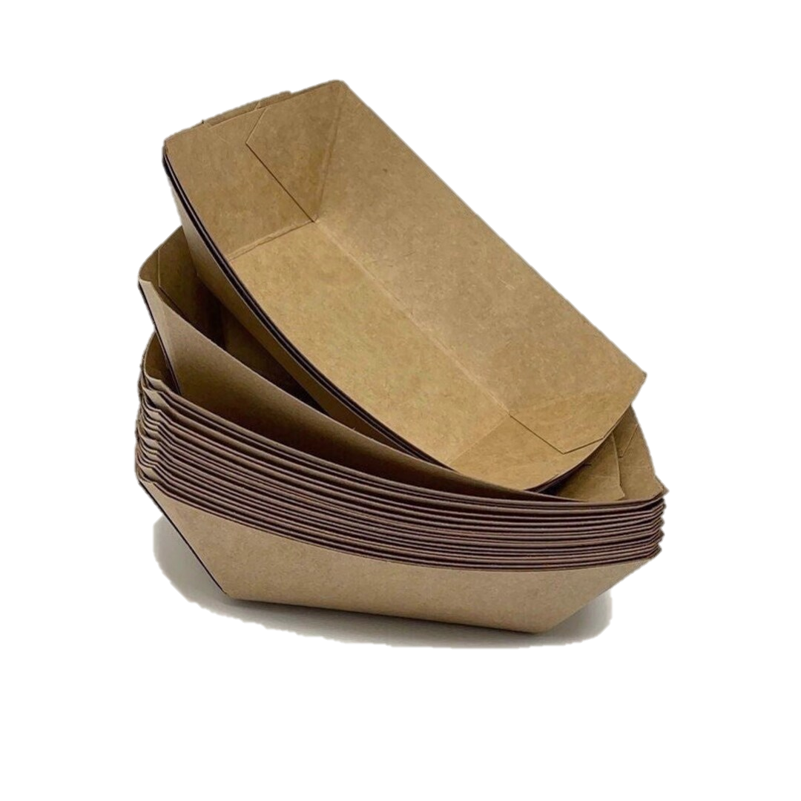
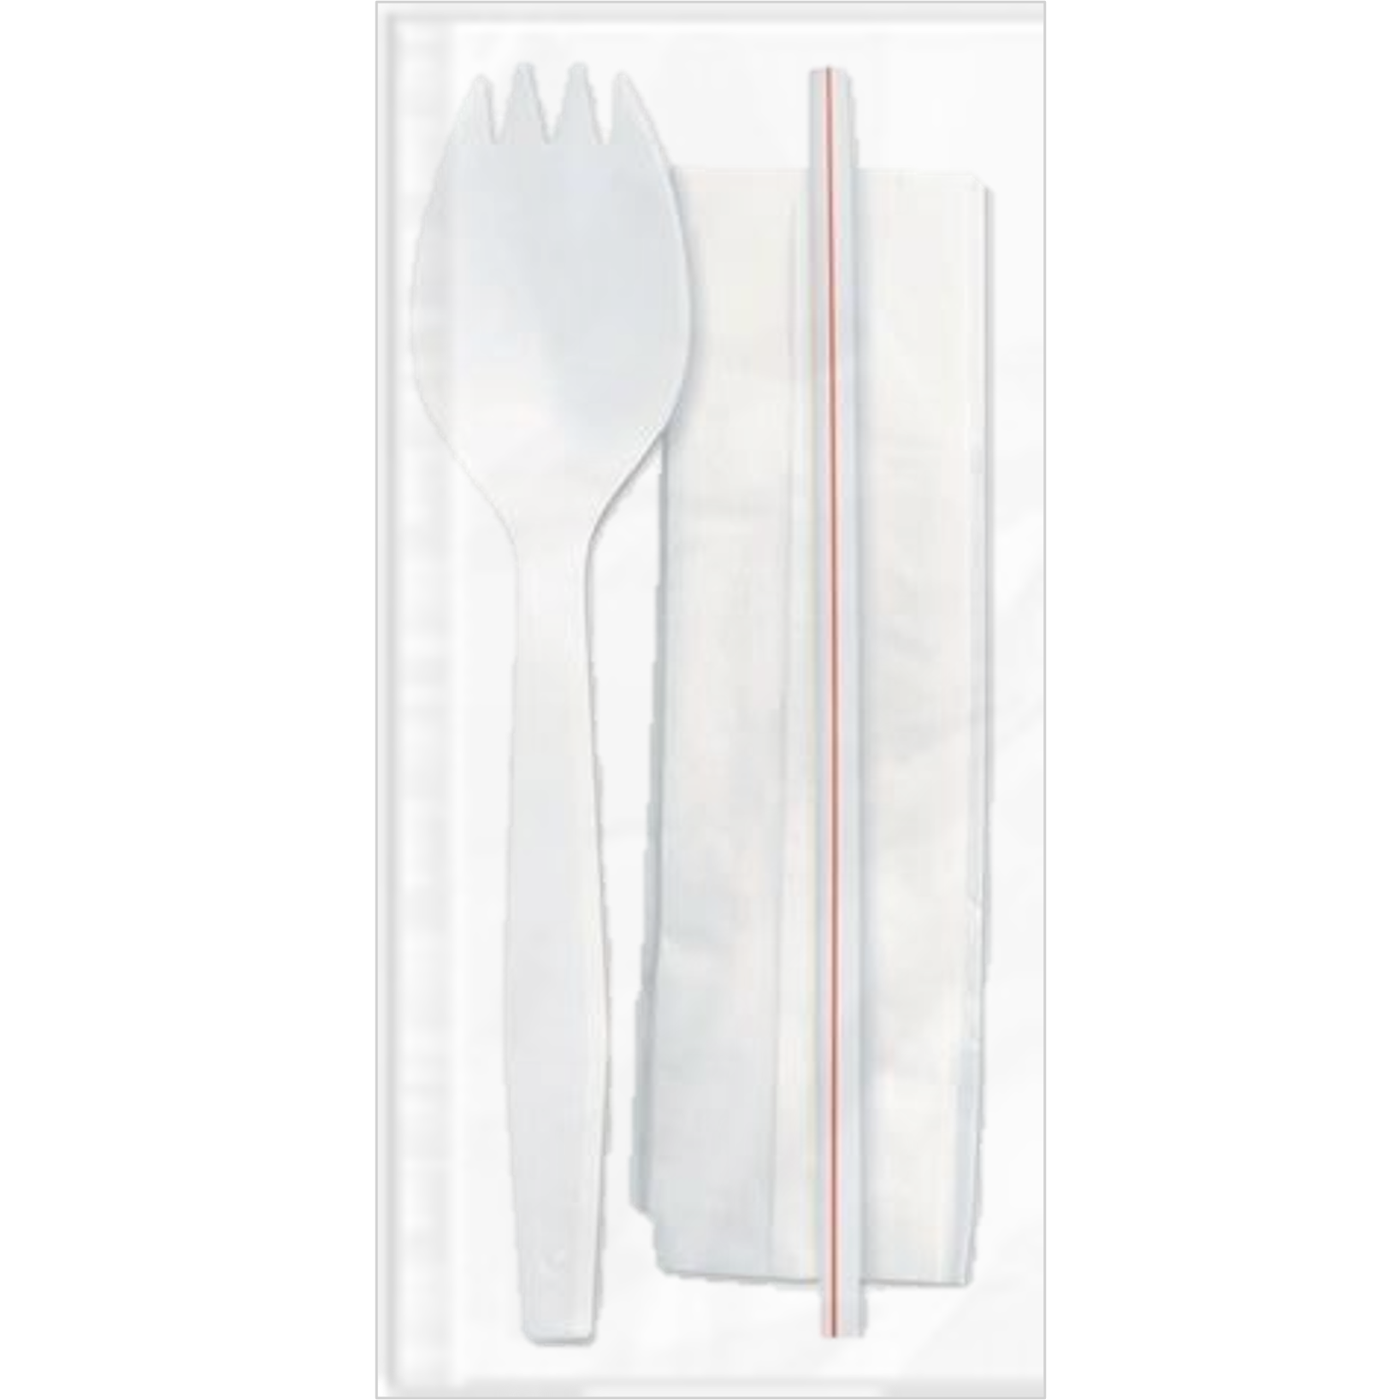
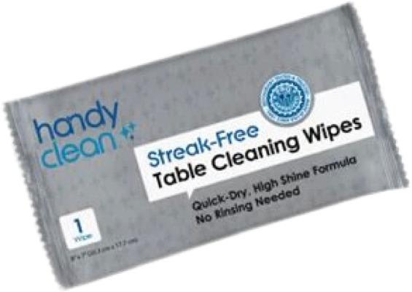
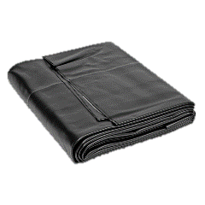
Supplies Needed
The following items will need to be available for breakfast meal service. Provided items are based on participation, not class enrollment.
Trays (3 lbs)
2 food grade bags per BIC classroom share table
Table
Cleaning
Wipes
Sporkette’s
Trash
Bag
Liners

Slide 50

Daily Building And Grounds BIC Duties
The Plant Manager and Building and Grounds workers’ daily duties include
  Placement of trash containers in a designated location.
  Clean up large spills and spot cleaning as requested, during or after meal service.
  Collecting trash removed from the classroom by students:
    Placed outside the door of a classroom.
    Centrally located between classrooms.
    At the entrance/exit of a building.
  Multi-Level schools:
    Near elevator ( IF applicable).
    Near the Stairwells.
  Dispose of collected BIC trash into the dumpster.
  Re-line trash containers as needed.

Slide 51
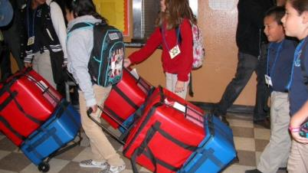
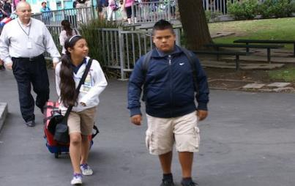
Role of The Delivery Team For BIC
The delivery team has the following responsibilities:
Pick up the insulated bags.
Deliver bags to the correct classroom.
Set up serving area and POS inside classroom.
Return insulated bags to the correct parking space within 10 minutes of the end of service.

Slide 52
Post Service
Notes:
TELL:The BiC bags are returned and the leftover amount are recorded on the production worksheet

Slide 53
Returned BIC Bags
When BIC bags are returned from the classroom, check for inconsistencies between the amount of meals checked on the “Breakfast Meal Count Form” and the amount of meals taken by the classroom.
When there are too many or too few check marks communicate with the administrator that oversees the cafeteria for assistance in correcting the issue
If unable to receive an accurate count, the excess meal counts will be calculated and disallowed

Slide 54
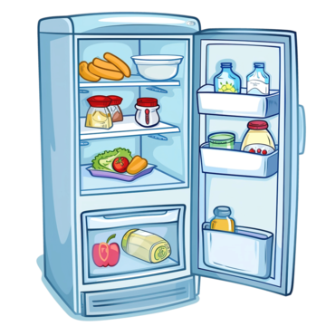

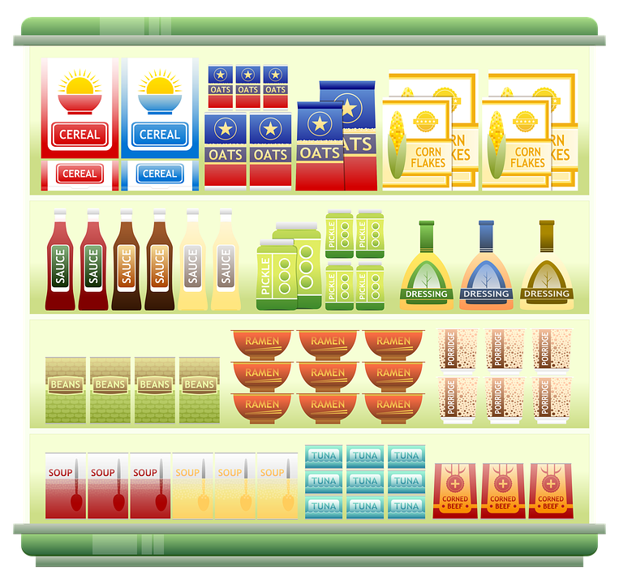

Items Returned In BIC Bags
  Items that will be returned to stock must be inspected for tampering.
  Store items separately from other inventory.
  Dispose of previously heated foods
Wash Fruits that will be reserved
  Refrigerate milk, juice, and yogurt immediately
  Store Shelf stable food according to FIFO rules

Slide 55


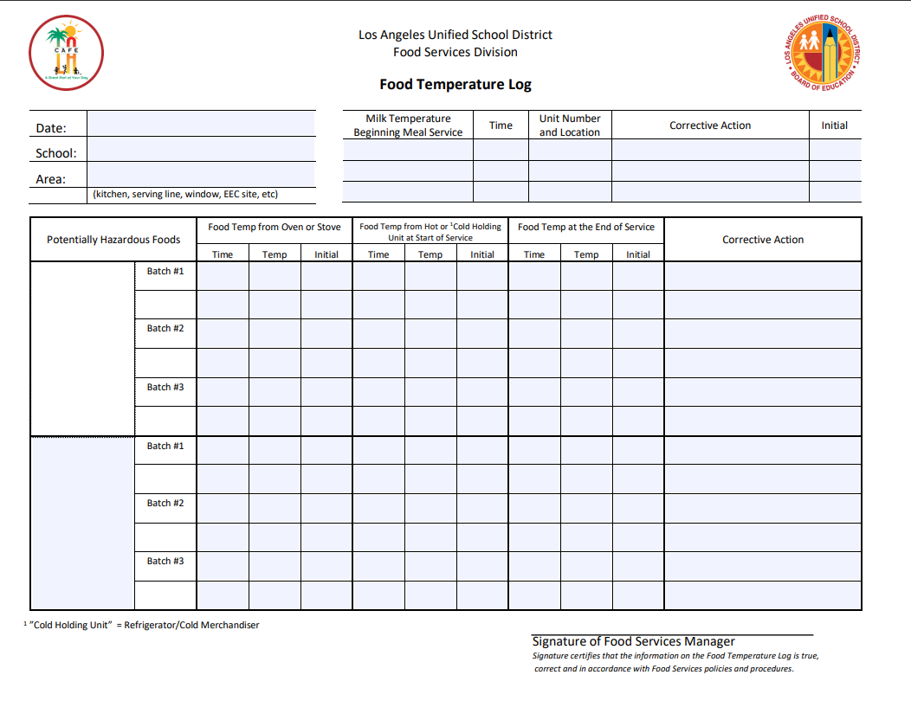
How to Return Perishable Items
Check the temperature of the refrigerated BIC items within three hours of being packed.
Document the temperatures on the Food Temperature Log.
Immediately place milk, juice, and yogurt that will be reused for service in a refrigeration unit.
If the temperature is below 45° serve items for same-day lunch/supper or next-day breakfast service.
If the temperature is above 45° discard the items and adjust the “Production Worksheet.”

Slide 56
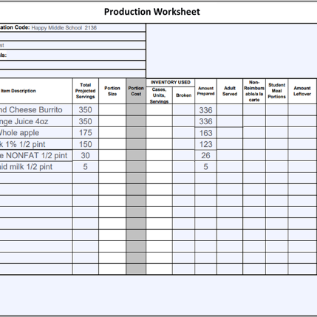
Recording Leftovers Count
Unserved hot entrees are recorded as leftovers. Do not included hot share table leftovers.
Unserved hot entrees
Cold and shelf stable items suitable for reservice may be returned to stock. Record the total of the unserved and share table leftover quantities together.
Other Leftover Items:
Unserved
Share Table
= Amount Leftover
20
43
61
71
17
0
  Count and record the unserved quantities and the share table leftover quantities separately in the comments section of the “Production Worksheet.”
Unserved leftovers – burritos 20 , juice 23, apple 36, 1%milk 29, N.F 6
Share table leftovers burritos 20, Juice 20,apple 25 , 1% milk 42, N.F. 11
Notes:
TELL:The BiC bags are returned and the leftover amount are recorded on the production worksheet

Slide 57
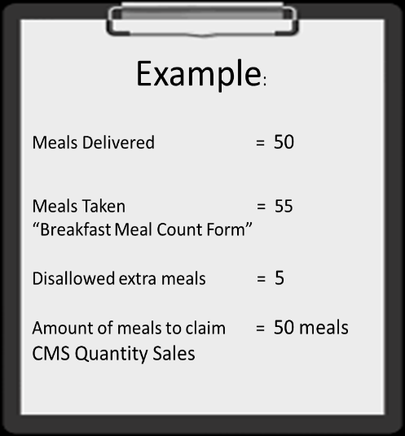
Disallowed Breakfast Meals
The BIC claim must be reduced when there are more students checked on the “Breakfast Meal Count Form” than the amount of food provided to the classroom.
Sites will reduce their claim by using the number of meals prepared versus the number of meals marked as served to students

Slide 58
Consolidation Report
Notes:
In the following slides, we will go over the following:
BIC Daily Meal Count Consolidation
CEP Daily Entry
Non CEP Daily Entry
Adult Meals

Slide 59
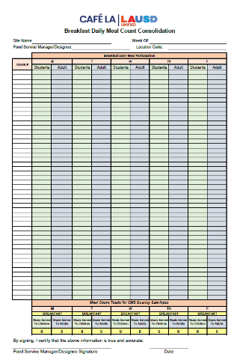
The Purpose of the
Daily Meal Consolidation Report
As a response to previous audits the “Daily Meal Count Consolidation Report” was implemented to help reduce the amount of waste produced.
It is mandated to complete daily
Use consolidation reports to assure BIC claimed meals are accurate
Use the consolidation report to help with forecasting based off the needs of each classroom

Slide 60
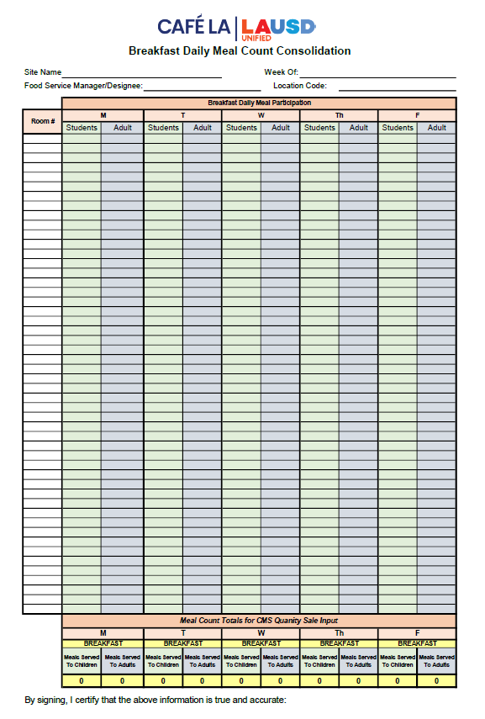
Daily Meal Consolidation Report
FSM will fill in the site name, week, name and the location code.
Beyonce Training Academy 9/8 -09/12/25
Blue Ivy Carter 8081
Fil in the room # and meal counts for the day:
  Student meal counts
  (green column)
  Adult meal counts
  (blue column)
  Consolidation report is used for one week of meal accounting
The consolidation report has a formula that will auto-populate the total meal counts for students and adult meals served. This will provide an accurate meal count for MISC Counts entry in Newton at end of day when selecting Post Operating Day.

Slide 61
Consolidation Form
The FSM/Designee will conduct a self-audit at the end of the week to confirm all numbers were entered correctly.
FSM will print, sign, and date the consolidation form to certify that the information is true and accurate.
Check all supporting meal count forms for accuracy
Confirm all meal counts on the consolidation form were transferred into Newton correctly
Any errors identified must be corrected
Solange Knowles
8-15-25

Slide 62

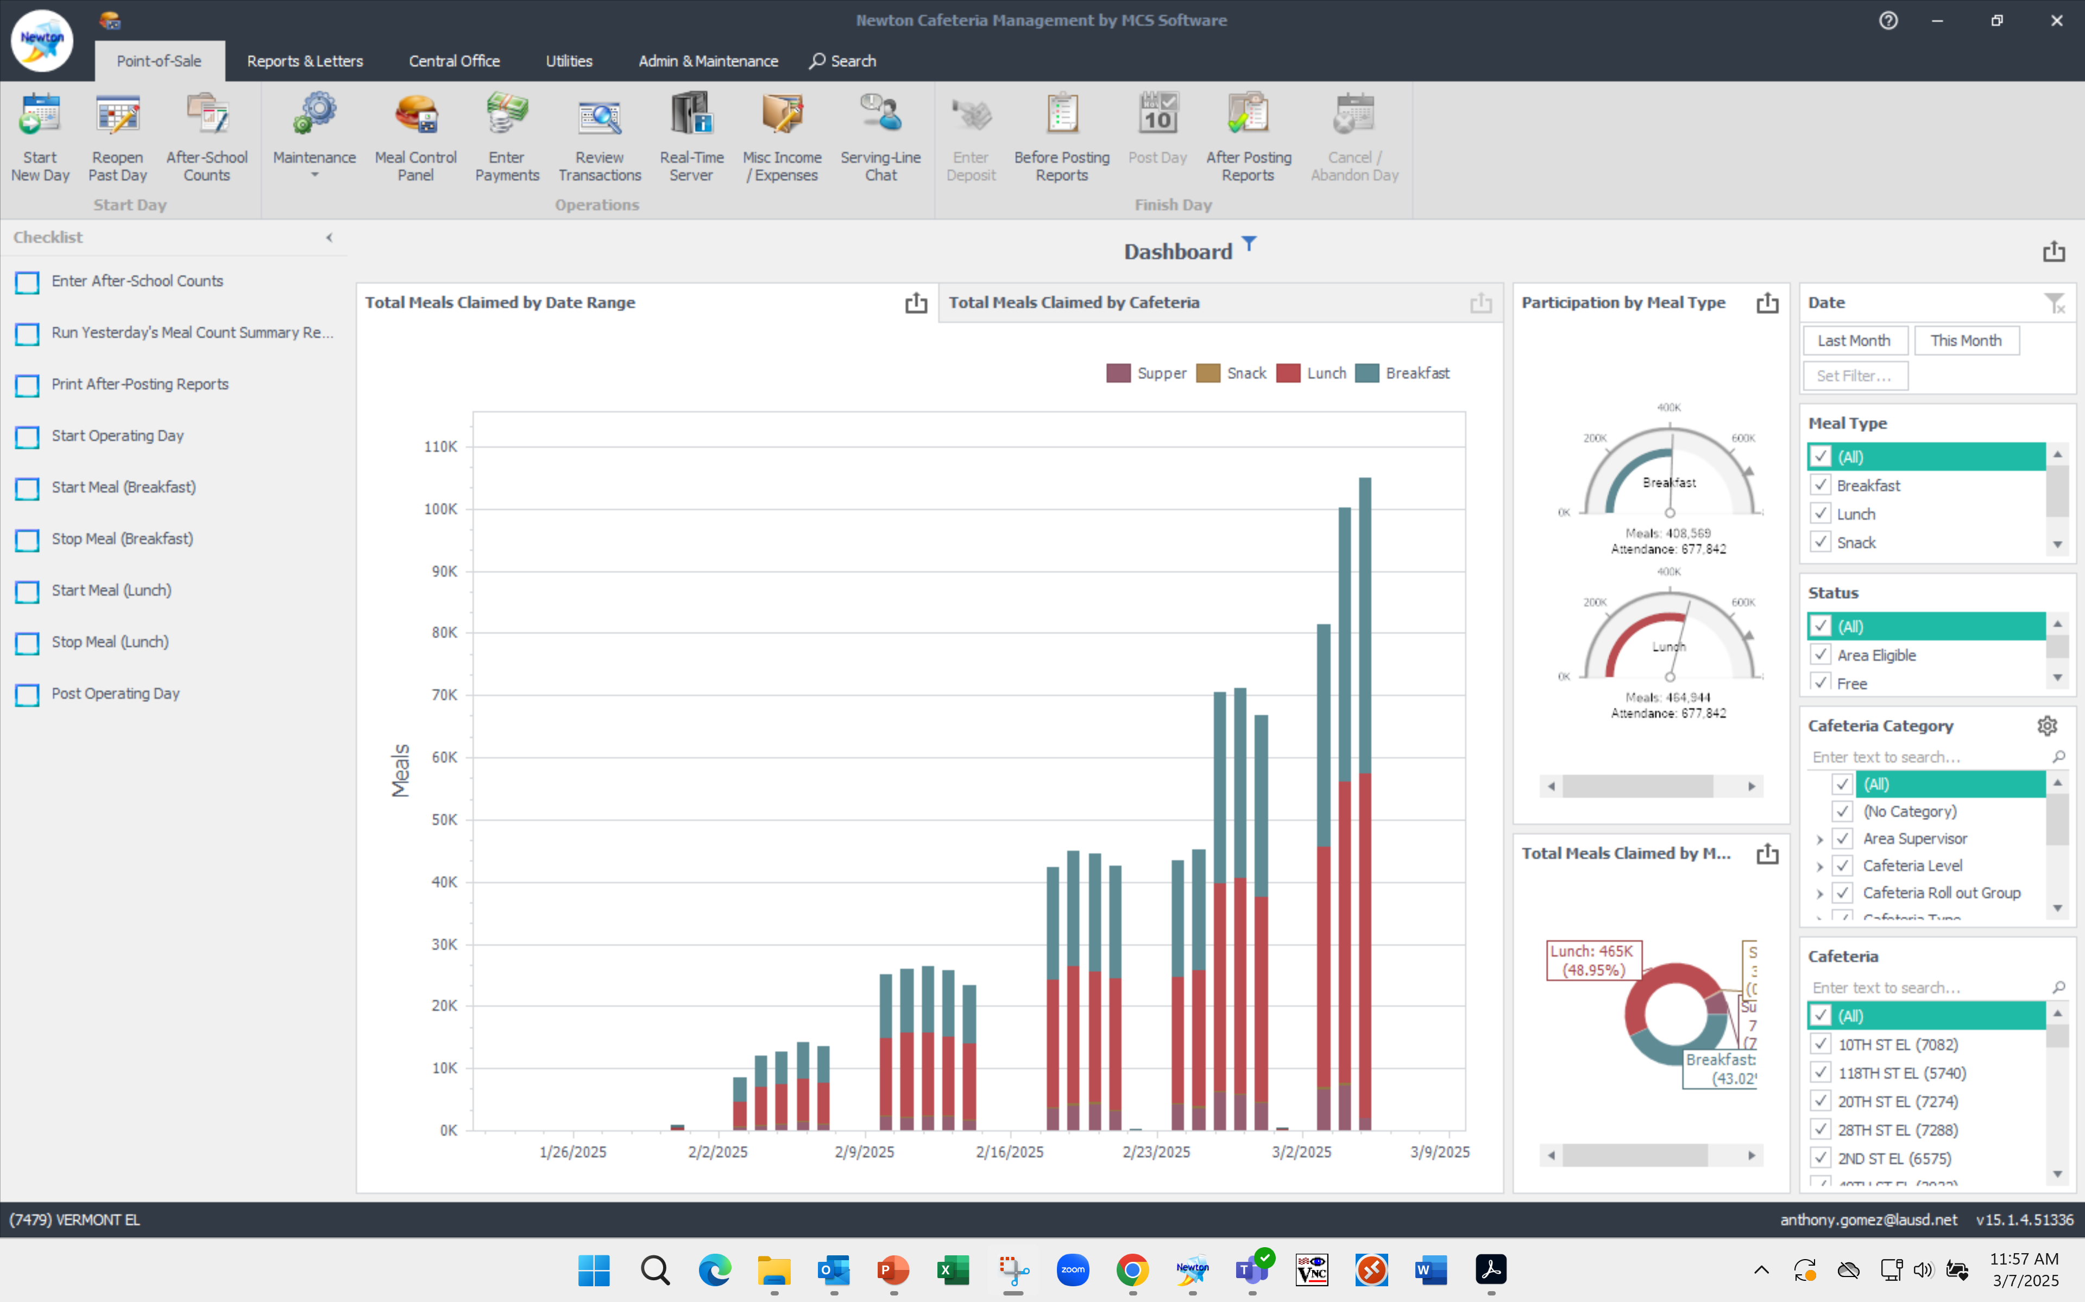
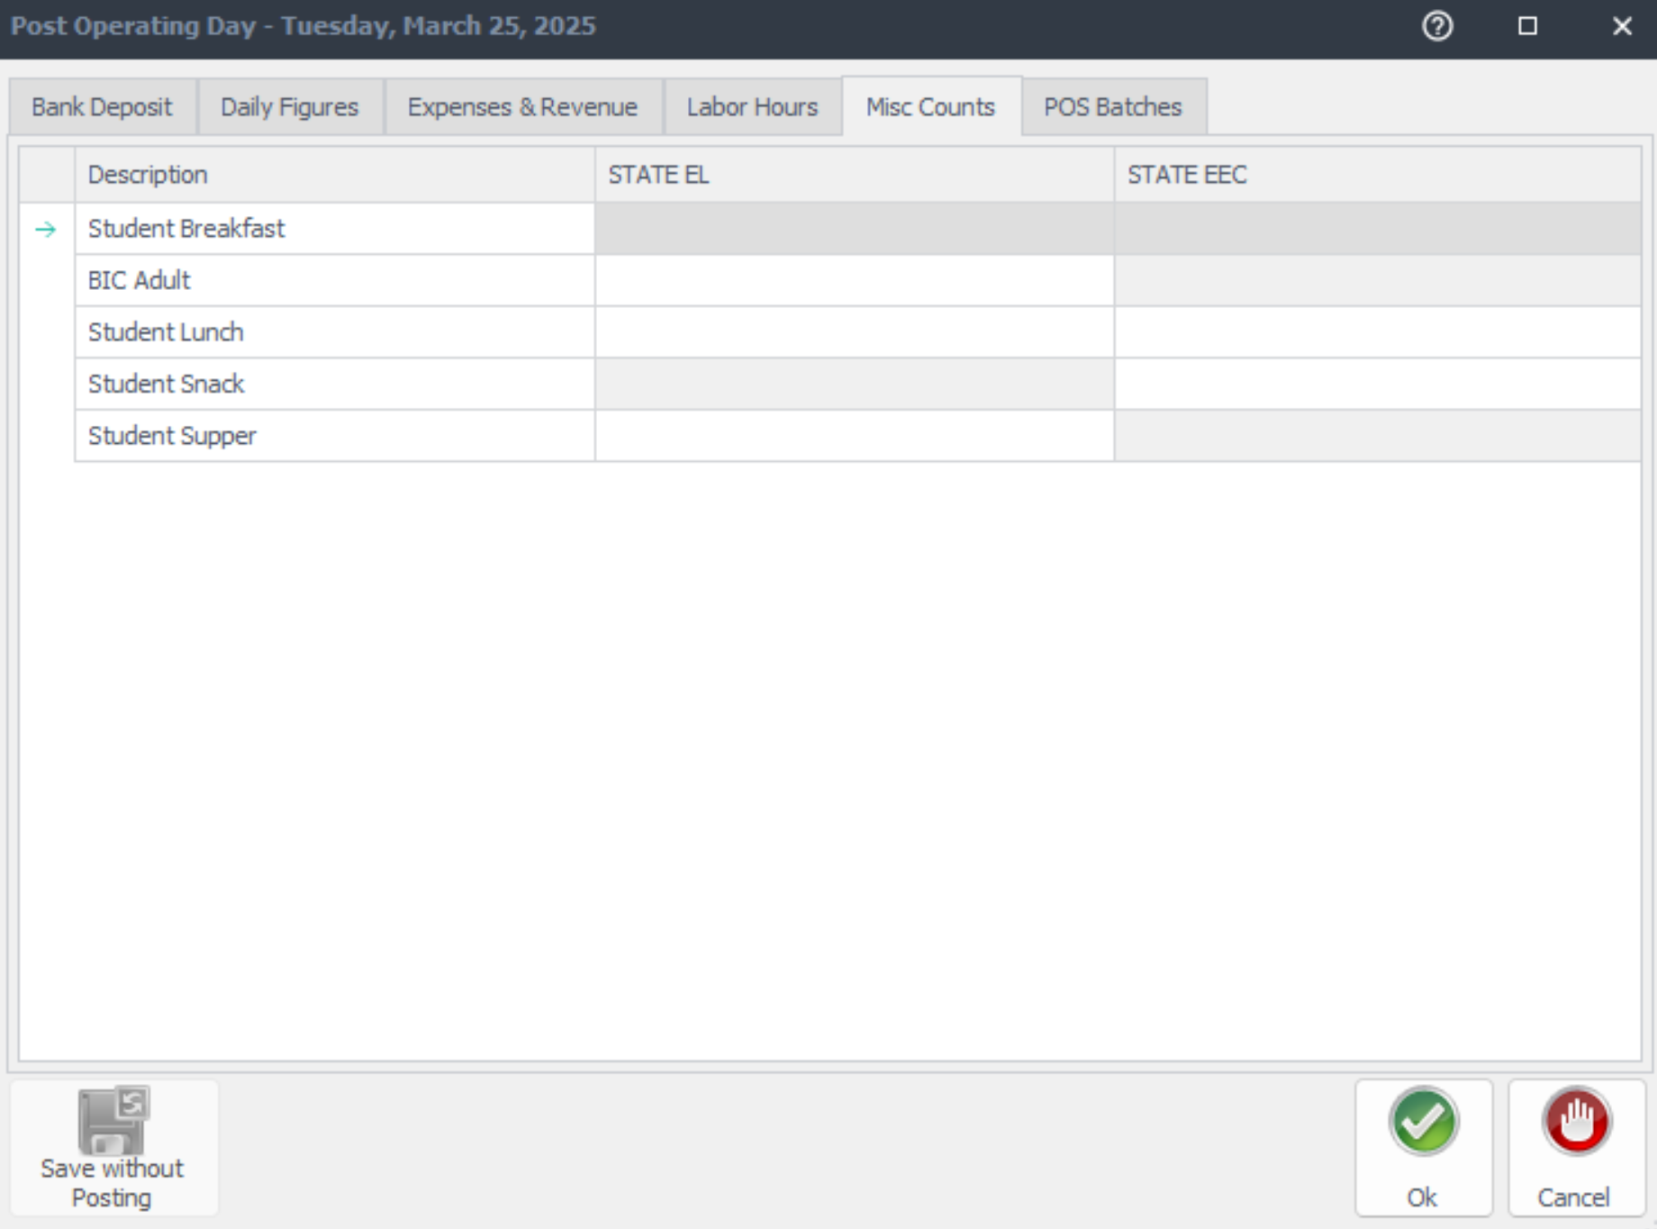
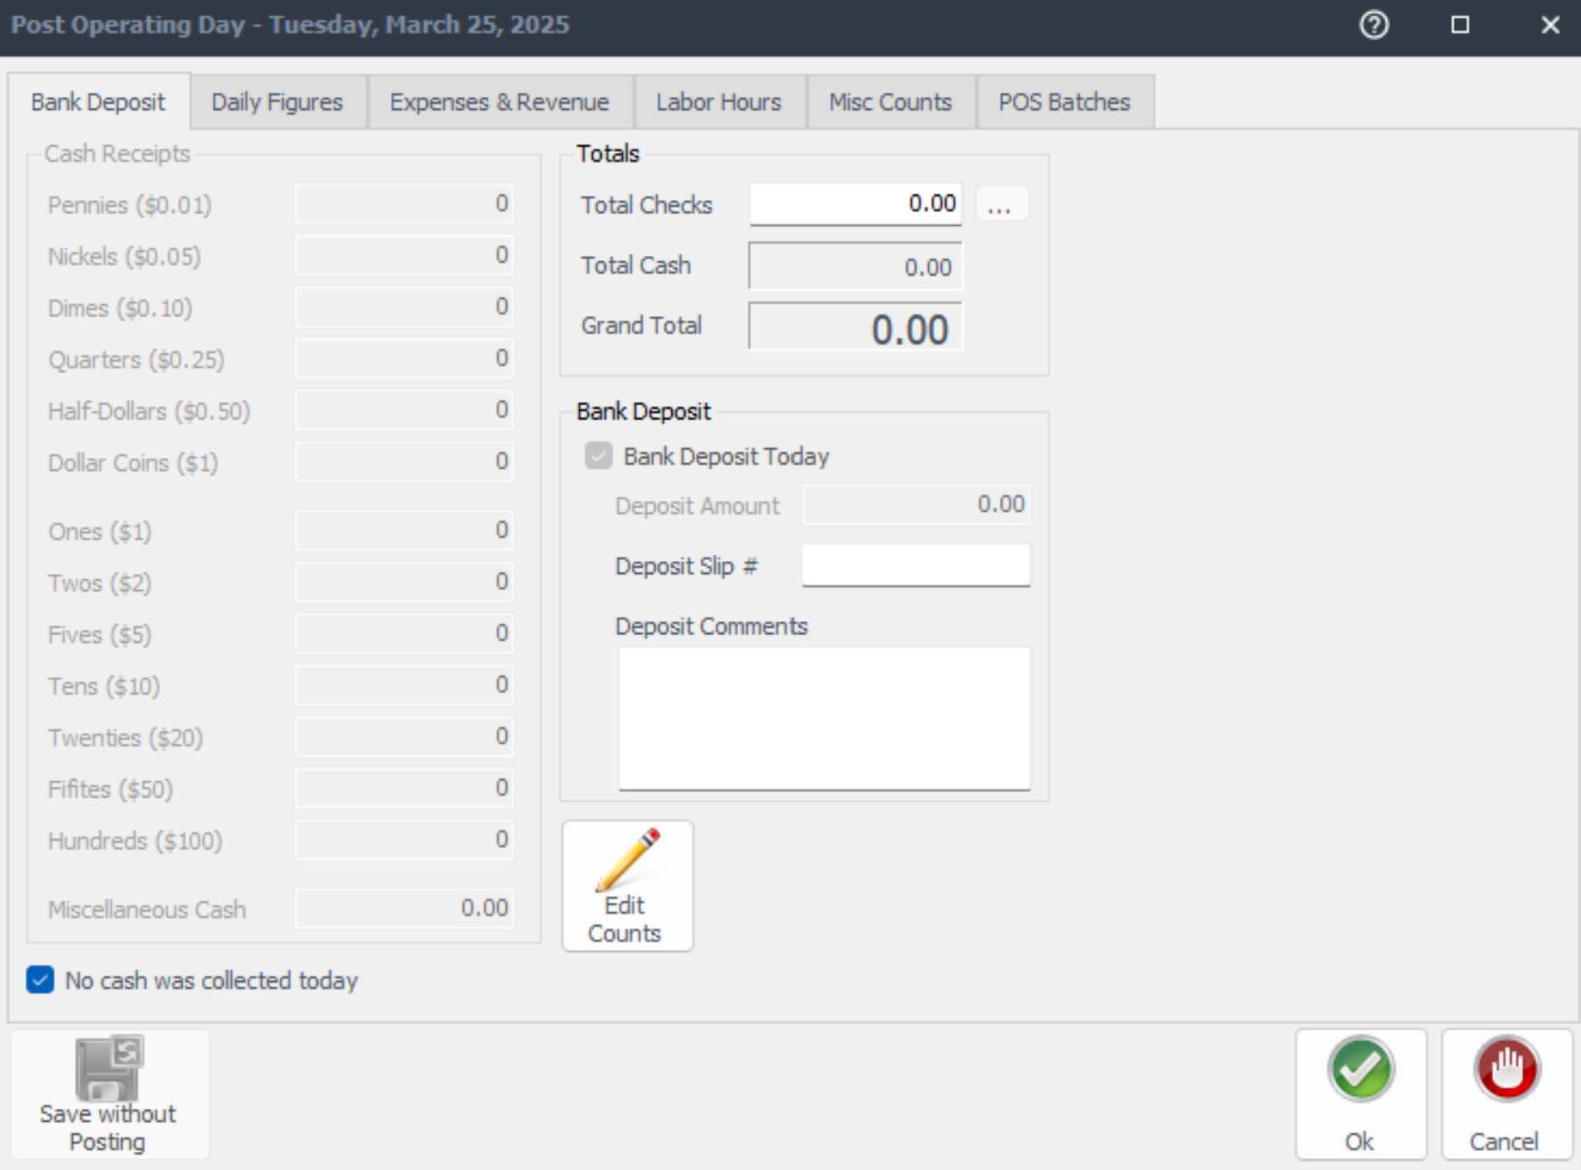
Using totals from the Consolidation Report input BIC meal counts and Adult BIC meals into Newton at the end of day, using MISC Counts.
356
22

Slide 63
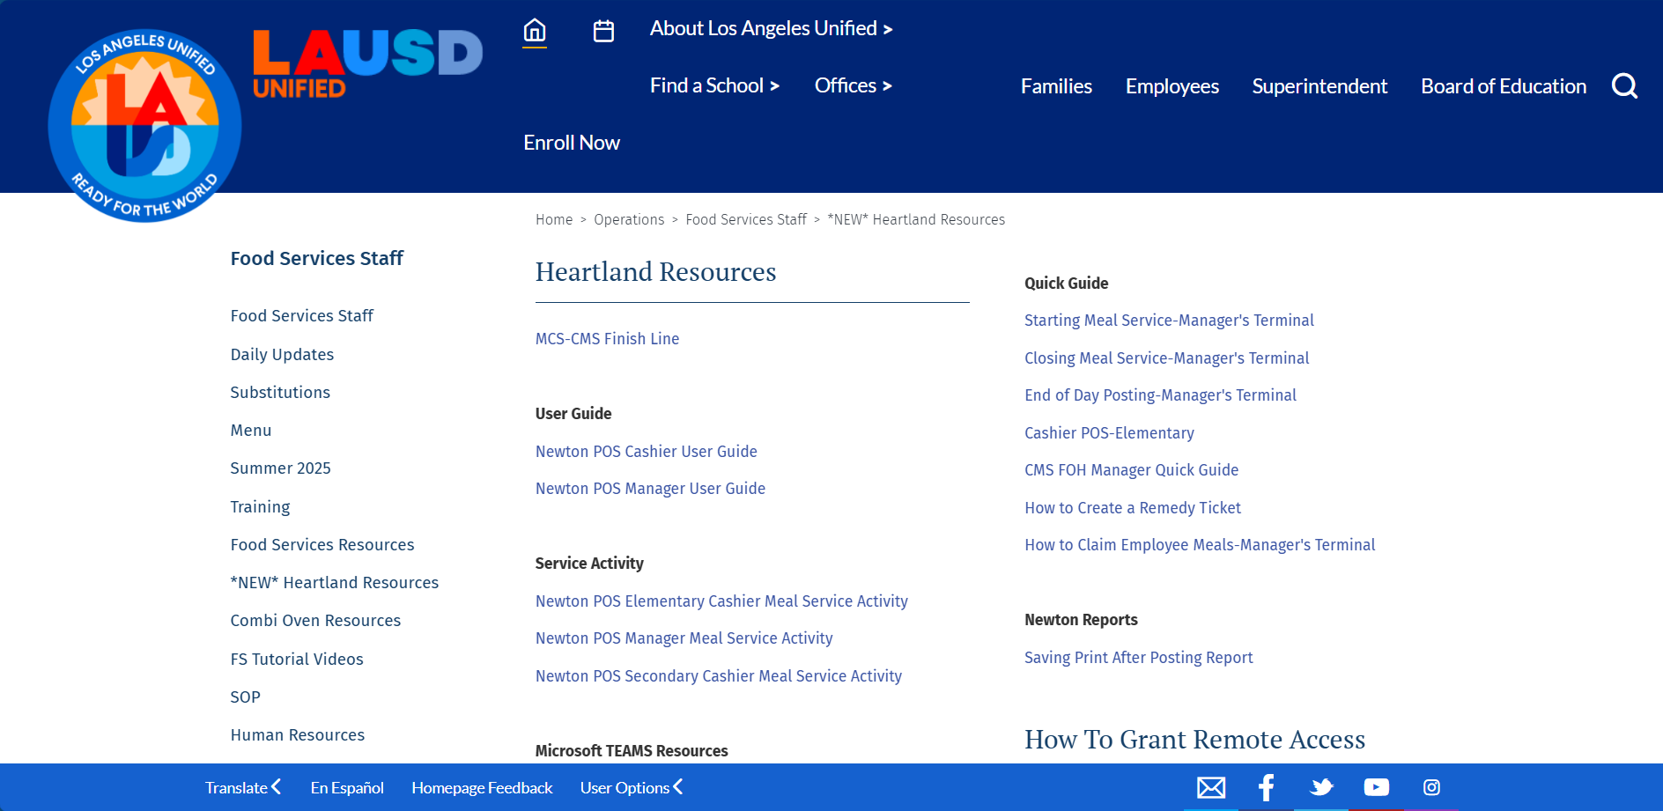
For more information on entering meal counts numbers and other Heartland information. Visit the Food Services Website under the “New” Heartland tab.

Slide 64
Classroom Observation

Slide 65
Classroom Observations
FSM or designee will visit 1-2 classrooms daily while meals are being served to ensure the BIC process is followed. Prior to your observations, communicate plans with the principal or administrator that oversees the cafeteria.
  If corrective action is needed, contact the principal/site administrator to review the findings.

Slide 66
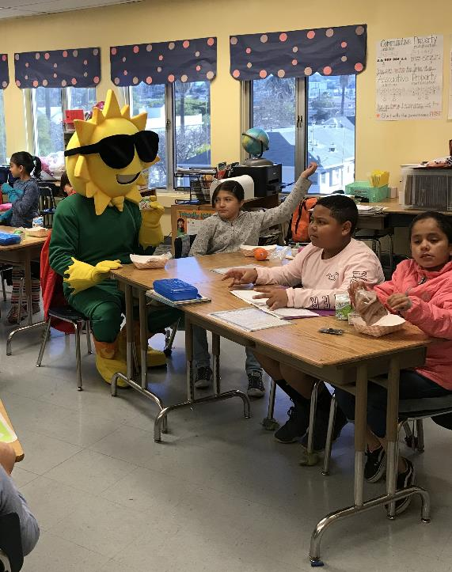
Classroom Visit
Manager’s will visit classrooms to gauge student interest and to ensure:
Students are selecting reimbursable meals
“Breakfast Meal Count Form” is completed correctly
Unserved and share table leftover items are returned to the cafeteria
Visits should take no more than a couple mins daily to collect information.

Slide 67
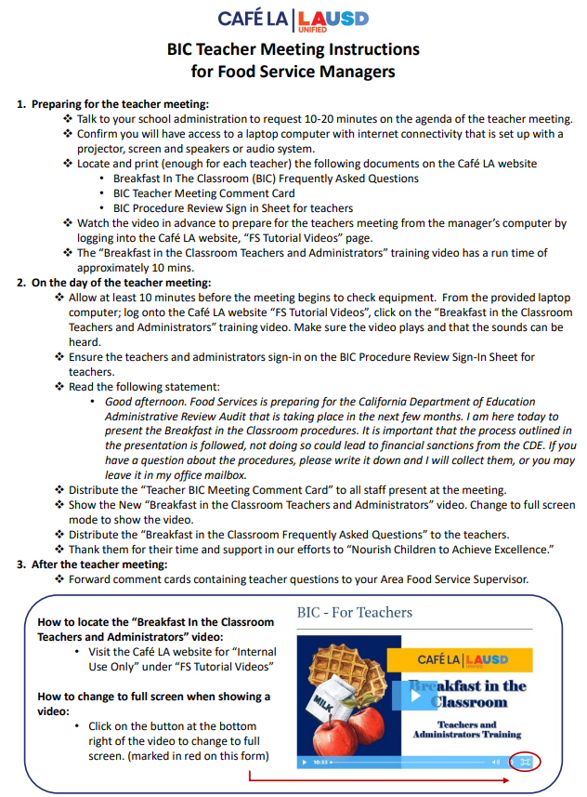
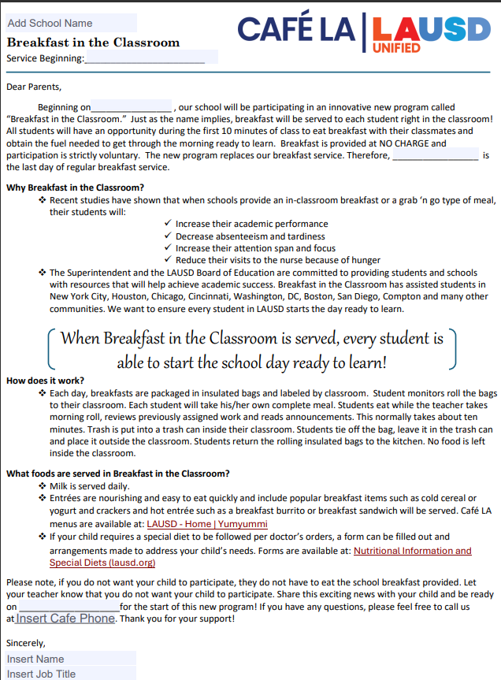
Communicating with Staff
When communicating with school staff and administration refer to the food services website under food services resources, subcategory BIC. Resources include:
    BIC teacher meeting instructions
    BIC FAQ sheet
    BIC Teacher comment card
    BIC Parent Letter

Slide 68
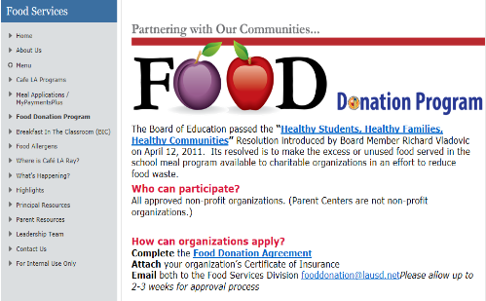
Food Donation Policy
To reduce food waste, the food donation policy was enacted to make excess or unused food served in the school meal program available to approved charitable organizations.
  Reference Guide REF-5634.0 for the food donation process must be followed
  For more information visit the Food Services Website

Slide 69

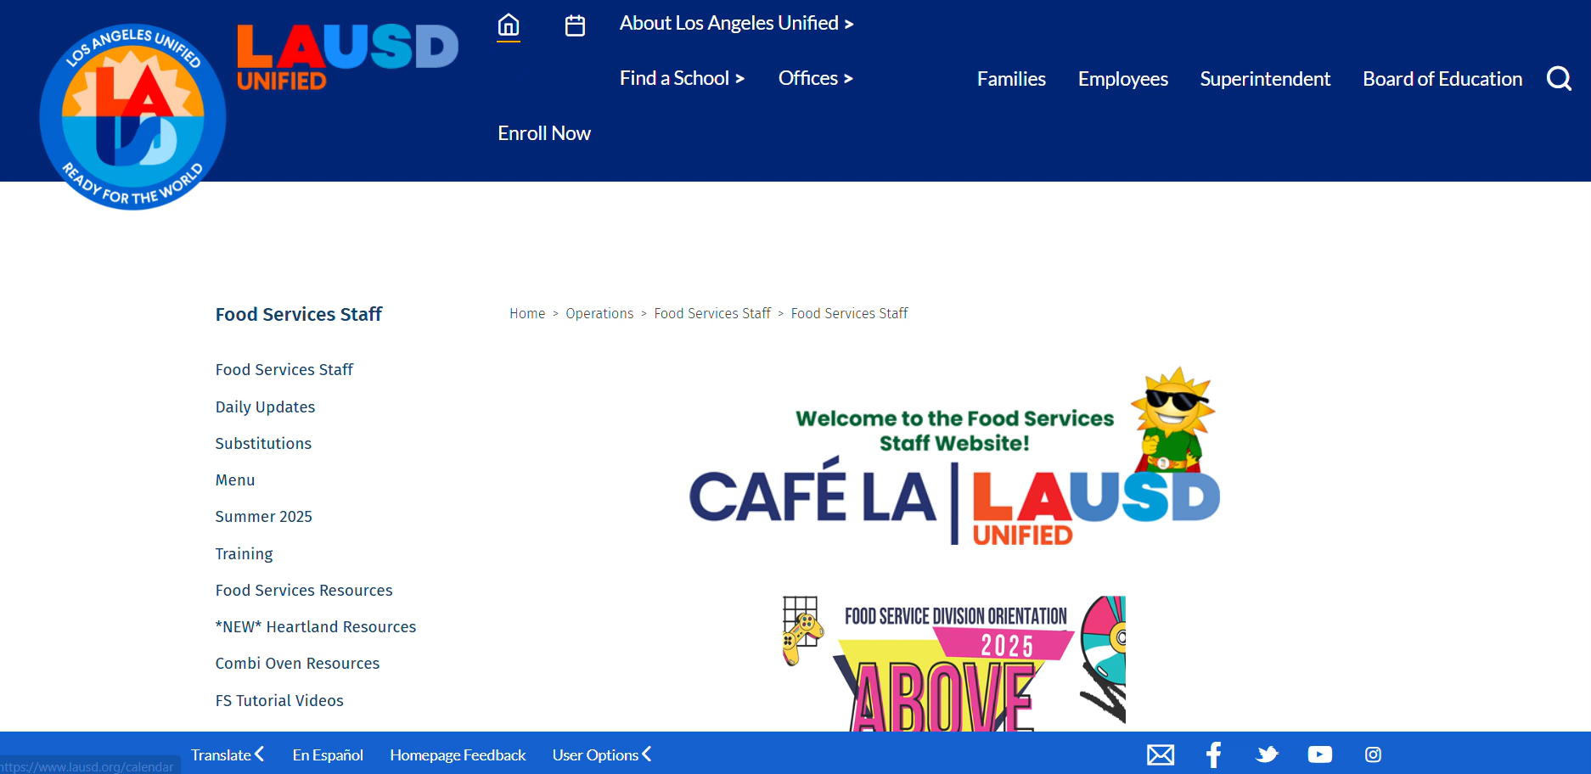
Finding Resources
All information in this training is located on the Food Services Website under BIC.
Food Services Website > Food Services Resources > BIC

